Slide 1
PURE Briefings 2017
Au library

Slide 2
Agenda
BFI – The Bibliometric Research Indicator
What does it take for a publication to be awarded points?
How are points calculated and awarded?
OA – Open Access
OA at AU
OA in PURE and the OA Barometer
Questions as we go

Slide 3
Introductory remarks
Deadlines
Submission: January 15th/February 1st
Validation: March 1st.
Why those deadlines?
AU key figures dues early march
Final BFI harvest on June 15 (new deadline)
OA harvest early january 2018
I assume basic familiarity with the publication editor in PURE.

Slide 4
What is BFI?
The Bibliometric Research Indicator (BFI) is a performance-based model based on a political agreement on the allocation of new basic funds (25%) of the Danish universities.
The model is based upon publications registered in PURE. As such, the university’s funding is partly our own responsibility– nobody is going to help us!
The indicator itself is a (relatively) simple metric – a BFI point - assigned a publication. These points are aggregated up to university level and translated to funding.
The final harvest is set for June 15. The scope of the harvest is always the previous submission year.

Slide 5
Rules for bfi classification
Publication category
Publication status
Peer Review
Publication type
Publication through serials or publisher from the authority lists
Proper affiliation of internal authors
Author role

Slide 6
Category, Status and peer review
En publikation indenfor kategorierne ‘Forskning’ og ‘Rådgivning’, kan udløse point.
Derudover skal publikationen være peer reviewed.
Derudover skal publikationen have status ‘Udgivet’.
But not all publication types can trigger points …
Category | BFI | Peer Review | BFI | Status | BFI
Research | ✓ | Yes | ✓ | In preparation | -
Commissioned | ✓ | No | - | Submitted | -
Communication | - |  |  | Accepted/In press | -
Education | - |  |  | E-pub ahead of print | -
 |  |  |  | Published | ✓
 |  |  |  | Not published | -

Slide 7
PubliCation types
Contribution to journal/Conference contribution in journal
- Journal article
- Conference article
- Letter
- Review
Book/anthology/dissertation/report
- Book
- Report
- Doctoral thesis
Contribution to book/anthology/report/proceeding
- Book chapter
- Article in proceedings
- Report chapter

Slide 8
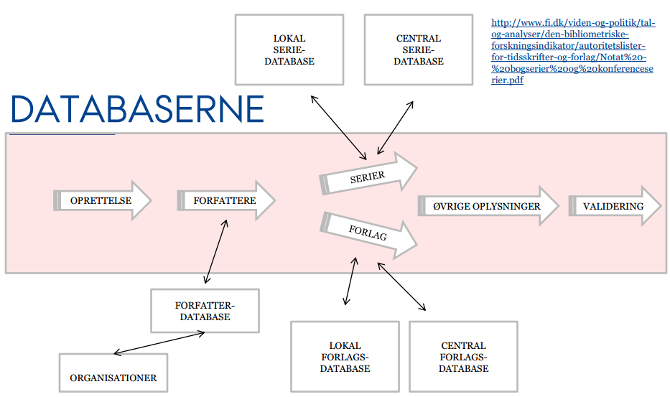
LOCAL SERIAL DATABASE
CENTRAL SERIAL DATABASE
AUXILARY DATABASES
Serials
Submission
Authors
Additional information
Valdiation
Publishers
AUTHOR
DATABASE
LOCAL PUBLISHERDATABASE
CENTRAL PUBLISHERDATABASE
ORGANISATIONS

Slide 9
Central databases
The lynchpin of the BFI system are two authority lists, one containing serials (journals, book series and conference series) and one containing publishers.
Each authority list is divided into two levels of which level 2 is the best http://ufm.dk/forskning-og-innovation/statistik-og-analyser/den-bibliometriske-forskningsindikator/autoritetslister
Publishing through a channel on a authority lists awards points if the other rules are met.
In PURE a point triggering channel is ALWAYS from the central databases. If a publication is associated with a channel from the local database, it will NOT be awarded points, whether or not it meets the other rules.

Slide 10
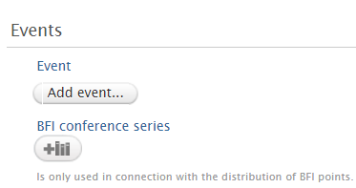
Book- and Conference series
Book series can be associated with:
Book/anthology/dissertation/report
Contribution to book/anthology/report/proceeding
Conference series can be associated with:
Contribution to journaæ
Contribution to book/anthology/report/proceeding

Slide 11
Precedence of series
A precedence rule takes effect if more than one BFI publication channel is associated.
The precedence rule determines which publication channel awards points.
Precedence trumps BFI level.
If more than one book series is associated, the first one determines BFI points.
Precedence order
1. Conference series*
2. Book series / Journal
3. Publisher
* When assocating conference series, the ‘event’-field must contain a value – otherwise the conference series wil be disregarded.

Slide 12
Author affiliation
ALL authors must be registered - not just yourself or the authors you are responsible for.
Proper athour affiliation is essential in connection with fractioning BFI points.
The publication determines the number of authors, the order and their affiliations.
Only the role ‘Author’ qualifies for a BFI classification.

Slide 13
BFI Points
 | Level 1 | Level 2
Scientific monographs | 5 | 8
Scientific articles in journals and book- and conference series. | 1 | 3
Anthology contributions | 0,5 | 2
Doctoral theses | 5
Patents | 1

Slide 14
BFI Points - collaboration
There is a reward system for collaboration across organizational boundaries both nationally and internationally
› The point value of publications with authors from different universities is multiplied by 1.25 before fractioning is carried out.

Slide 15
PURE CBS
PURE SDU
PURE AAU
PURE DTU
PURE RU
PURE AU
The BFI system
PURE KU
PURE ITU

Slide 16
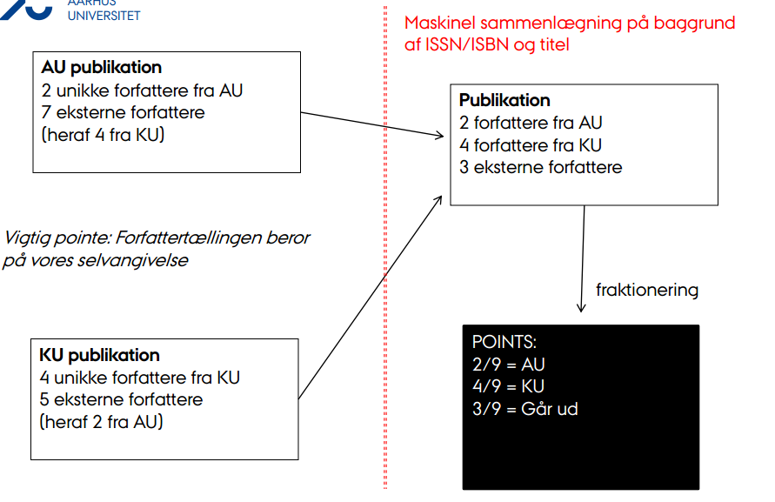

Slide 17
Points awarded – two examples
A scientific article published in a level 2 journal.
There are five authors – all from Aarhus University.
It is awarded 3 points that are divided by 5.
Aarhus University receives:
(3 / 5) * 5 = 3 points.
A scientific article published in a level 2 journal.
There are five authors– two from Aarhus University, one from Copenhagen University and two from a foreign university
It is awarded 3 points that are multiplied by 1,25 and then divided by 5.
Aarhus University receives:
((3 * 1,25) / 5) * 2 = 1,5 points.
Copenhagen University receives :
((3 * 1,25) / 5) * 1 = 0,75 points.

Slide 18
What is the monetary value of a point?
The monetary value of a point is determined by two variables
Basis funding size for the main research area
The total number of points generated at a national level
What is a publication worth to AU?
Point value for main research area * Multiplier for collaboration / Number of authors * Number of internal authors (least possible BFI share is 1/10)
The monetary value of a point and a given publication can not be calculated until the end of the harvest year.
It is therefore difficult to translate points directly to funds on a publication or author level.

Slide 19
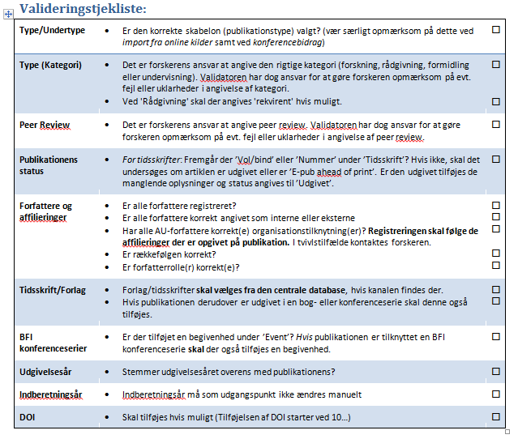
Validation checkliste
http://medarbejdere.au.dk/pure/brugervejledning/publikationer/hvordan-validerer-jeg/
…and it’s a question of good reliable data – not a points race.

Slide 20
The BFI system
In June 2014 the new BFI system was launched by the Danish Agency for Science and Higher Education. The system developed by Schultz.
The system is open to the public. Employees at Aarhus University can access the system via WAYF.
https://bfi.fi.dk
As the system harvests on a daily basis, it distinguishes between temporary and final points (the latter is awarded in early October after final harvest and conflict handling).

Slide 21
support
You can reach the central PURE Support at AU Library by mail at pure@au.dk
The PURE Support is manned by a core team of PURE specialists from AU Library.
http://medarbejdere.au.dk/pure/support/spoerg/

