Slide 1
Future // Arts
Academic Citizenship
Rikke Toft Nørgård, Lektor, Ph.d.
Søren S.E. Bengtsen, Lektor Ph.d.

Slide 2
Vi vil gerne invitere til en samtale & samtænkning omkring
Future - Arts - Academic - Citizenship
Præsentation af nogle nøglebegreber inden for de 4 felter
=> samtalestartere & tanketermer
En skitse til Future//Arts der ikke er negativ & defensiv
men positiv & konstruktiv
=> vokabular & handleramme
Notes:
Hvem vi er
Hvor vi kommer fra
Noget vi forsker i , udvikler og underviser omkring

Slide 3
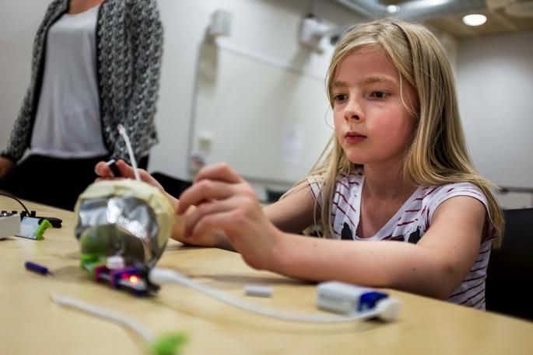
Future-making: Fremskrivning & spring
At udvikle og opdyrke mulige fremtidsscenarier og fremtider gennem ‘fremtids-skabelse’ => To typer futurology @arts
DIAGNOSE - FREMSKRIVNING
Konvergent problem-løsning
Diagnosticering: at finde problemet
‘Wicked problems’
Fremskrivning: mulige løsninger
Mål: finde frem til mulige løsninger på aktuelle samfundsudfordringer
Professionelle borgere: bygger på samfundsbehov & erhvervsuddannelse (det kendte & nyttige)
FANTASI - SPRING
Divergent ide-skabelse
Fantasi: at få en ide / at forestille sig
‘Strange ideas’
Spring: mulige verdener
Vision: skabe nye verdener/ fortolkninger der får ting til at springe andre steder hen
Revolutionerende borgere: bygger på samfundsdyder & samfundsvisioner (det ukendte & unyttige)
Notes:
2 x 2 dynamikker arts/STEM + diagnose & drøm - imagination - being imaginative - forestillingskraft
‘call for futre-making’ fra diverse stakeholders hvis vi læser på tværs af poliicy, organisationer, futuroligists,
centrale tandhjul/ begreber der kan bidrage til udviklingen af et vokubaler for hvad det vil sige på ARTs

Slide 4
Fremtids-skabelse = balancering af vægtskålene
“Several Republicans have portrayed a liberal arts education as an expendable, sometimes frivolous luxury [...] have called for more welders and fewer philosophers [...] criticized anthropologists [...] belittled gender studies [...] Democrats have, for the most part, avoided denouncing the humanities, but they have argued that education and training should be better aligned with the job market” (Cohen, 2016)
“We know that engineering and the humanities differ not just in the subject matter but in the very kinds of thinking they encourage [..] Technology does not proceed along a preordained single path, as one might suppose from a textbook or problem-solving approach. Like literature, engineering sometimes work not by satisfying recognized needs but by creating the needs it satisfies” (Ottino & Morson, 2016)
“Innovation is not simply a technical matter but rather one of understanding how people and societies work, what they need and want. America will not dominate the 21st century by making cheaper computer chips but instead by constantly reimagining how computers and other new technologies interact with human beings” (Zakaria, 2015)

Slide 5
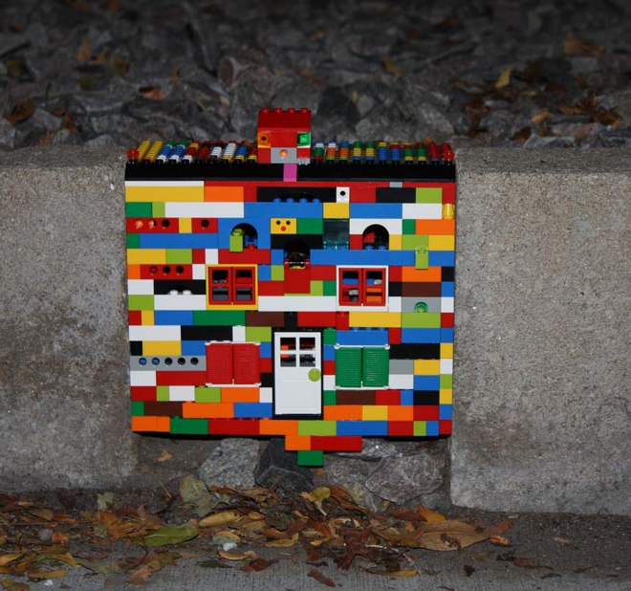
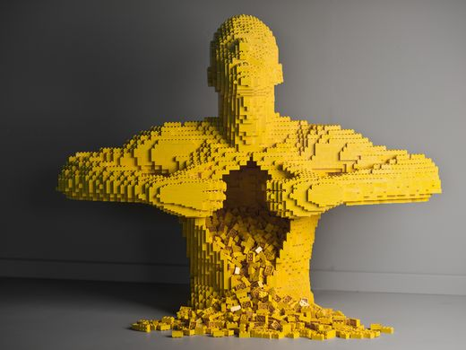
Future//Arts - Arts//Futures
Arts som fagligt bosted - at bygge bosteder på og have Future//Arts som hjemstavn
Arts fakultetet som ‘et særligt sted at bo’ der skaber ‘særegne’ rum, pladser og miljøer
Fremtidsskabelse 1: Arts living guilds (guidelines for fremtidens Arts-miljø)
Arts som fag-identitet - at udivkle en signatur for Future//Arts
Arts didaktik, pædagogik, læring & dannelse som ‘en særlig signatur’ der skaber ‘særegne’ hænder, hoved & hjerte
Fremtidsskabelse 2: Arts signaturer i bredden & dybden (workshop i oktober)
Arts som vidensfelt - samskabelse af kraft-eksempler på Future//Arts
Arts forskning, undervisning & udvikling som ‘en særlig viden’ der skaber ‘særegen’ tænkning, tilgang og tilværelser i verden
Fremtidsskabelse 3: Arts wicked problem/strange ideas kraft-eksempler & sammenhængs-kræfter (principper, mønstre & formater)
Notes:
T - på tværs og i dybden (sammenhængskraft på arts og på faget)

Slide 6
Academic: Universitetet i, for og fra samfundet
Modus 1-universitetet (egen-værdi & ‘tempel for det oplyste liv’)
Viden: Lukker sig om sig selv og disciplinen, universel, samfundskommenterende, samfundsopdragende
Uddannelse: Uddanner indad, forskning og formidling, selvopretholdende, ‘lukket’ originalitet
Institution: Mangel på samfundsmæssig interesse og engagement, lukket geografi, lukket ontologi
Modus 2-universitetet (nytte-værdi & ‘fabrik for fremtidens arbejdskraft’)
Viden: Retter sig mod samfundets behov, situeret, politisk drevet, økonomisk forankret
Uddannelse: Uddanner udad, omskiftelig, kompetencestyret, færdighedsorienteret, problemløsende
Institution: Producent, industri, problemknuser, task force, åben geografi, lukket ontologi
Modus 3-universitetet (samfunds-værdi & ‘medborgerhus for kritisk samfundsskabelse’)
Viden: Undersøgende samspil med samfundet omkring værdier, kultursyn, social identitet, mening, fællesskab
Uddannelse: Dialog med institutioner, organisationer, virksomheder, sociale miljøer, offentligheden, borgerne
Institution: Kritisk engagement som er historisk åbent, geografisk åbent, ontologisk åbent
Notes:
Hvad betyder det så for ARTS?
Kobling til FUTURE slide

Slide 7
Barnett, 2015
“Graduates will do their professions or their organizations no service if they simply live out, however, reflectively, the roles assigned to them. Critical action demands that persons fully inhabit their actions; that they are brave enough to live out their understandings in the world. Without this bravery, without this living out of one’s comprehensions, a person’s life is diminished, but so, ultimately, are our institutions. Despite itself, the corporate world ultimately requires real selves, three-dimensional selves inhabiting all three domains of critical being. (…) If students are to prosper in the modern world, if they are to carry their world forward in worthwhile fashion, they have to become critical persons embodying critique in the three dimensions of knowing, of self, and of the world at the same time.” (Barnett, 2015, p.68-69)
“Of course, mere exposure to the wider society is not synonymous with an exposure, still less an engagement with the public sphere. The public sphere will only open if it enters the being of the student as having a claim on the student. To a large extent, curricula can be designed with the development of (...) knowledge citizenship in mind.” (Barnett, 2015, p.25)

Slide 8
Citizenship: Modus 3-universitetet
Viden: Kritisk faglighed
Integration af kritisk viden (faglig viden og metode), kritisk væren (personlig mening, kulturel værdi), og kritisk handlen (samfundsmæssigt bidrag, social sammenhængskraft)
Uddannelse: ‘Beboelse’
Lyttende og opmærksom på omverden: Tale på vegne af andre, på vegne af dem, der ikke er her mere, der ikke selv kan tale, er forhindret i at tale, dem der kommer engang, endnu ikke har deres egen stemme
Samler (Gestell, gathering), samfundsmæssig samlen, drager domæner nær, skaber sammenhængskraft
Institutionen: Medborgerskab
(Gen-)Forbindelse af institutionen med den generelle livsverden (samfundet), etisk og moralsk dimension
Akademiske dyder: Sandfærdighed, oprigtighed, autenticitet, mod, storsindethed (magnanimity), omsorg
Notes:
Hvad betyder det så for ARTS?
Kobling til ARTS-slide

Slide 9
Nixon, 2008
“Chief among those virtues are accuracy and sincerity: the former (accuracy) relates to the problem of ensuring that one’s beliefs are true; the latter (sincerity) to the problem of how one ensures that one’s assertions express what one actually believes. What is primary at stake is our capacity for, and commitment to, truthfulness. In pursuing truth we are less concerned with the nature of truth and increasingly concerned with what it means to be truthful – to ourselves and others.” (Nixon, 2008, p.56)
“What is at issue is the moral ontology of professional practice. It is precisely because morality is ontological – involved in my development as a moral agent – that the virtues of truth, respect, and authenticity hang together: truthfulness is unrealiseable without respect; and truthfulness and respect rely, crucially, on the virtues of authenticity.” (Nixon, 2008, p.81)

Slide 10
4-rums model for udvikling af Future//Arts
ARTS STEDER
Salonen, atelieret, scenen, museet, biblioteket, skrivekammeret, studiet…
Opdyrkning af fællessteder & faglige steder @Arts i verden
ARTS SIGNATURER
Faglige signaturer i bredden
Faglige signaturer i dybden
Forskning, undervisning, udvikling
FUTURE//ARTS
ARTS//FUTURES
ARTS SAMSKABELSE
Vidensformer: Kraft-eksempler @Arts
Værensformer: hånd, hoved, hjerte @Arts
Institutionsformer: Modus 3 universitetet @Arts i verden
ARTS SAMFUNDSVÆRDI
Dyder & Visioner
Fremtidsskabelse: fremskrivning & spring
Medborgerskab: samspil, dialog, kritisk engagement

Slide 11
Referencer
7 anbefalinger til det fysiske studiemiljø, Aarhus Universitet 2016
Adamson, G. (2007). Thinking through Craft. Oxford: Berg Publishers.
Arvanikatis, J. & Hornsby, D.J. (Eds.) (2015). Universities, the Citizen Scholar and the Future of Higher Education. New York: Palgrave Macmillan.
Barnett, R. (2004). Learning for an unknown future, Higher Education Research & Development, 23:3, 247-260
Barnett, R. (2015). A Curriculum for Critical Being. In Davies, M. & Barnett, R. (Eds.). The Palgrave Handbook of Critical Thinking in Higher Education. (pp.63-77). New York: Palgrave Macmillan
Barnett, R. (2017 - in press). The Coming of the Ecological University. London & New York: Routledge
Barnett, R. & Bengtsen, S. (2017). Universities and Epistemology: From a Dissolution of Knowledge to the Emergence of a New Thinking. Education Sciences, 7(1), 38
Bengtsen, S. & Barnett, R. (2017a). Confronting the Dark Side of Higher Education. Journal of Philosophy of Education, 51:1, 114-131
Bengtsen, S. & Barnett, R. (2017b - in press). Realism and education: A philosophical examination of the ‘realness’ of the university. In Higgs, P. & Waghid, Y. (Eds.). A Reader in Philosophy of Education (pp.121-137). Capetown: JUTA & Company

Slide 12
Referencer
Bengtsen, S. & Barnett, R. (Eds.) (2018 - forthcoming). The Thinking University. A Philosophical Examination of Thought and Higher Education. Dordrecht & New York: Springer Publishing
Bengtsen, S. & Nørgård, R.T. (2014). Becoming jelly. A call for gelatinous pedagogy within higher education. Proceedings of the 9th International Conference on Networked Learning 2014, Edited by: Bayne S, Jones C, de Laat M, Ryberg T & Sinclair C. ISBN 978-1-86220-304-4
Cohen, P. (2016). A rising call to promote STEM education and cut liberal arts funding. In: The New York Times, Feb. 21 2016.
Filippakou, O. & Williams, G. (Eds.) (2015). Higher Education As a Public Good. Critical Perspectives on Theory, Policy and Practice. New York: Peter Lang.
Fung, D. & Carnell, B. (2016). UCL Connected Curriculum: Enhancing programmes of study. University College London, UK
Gregerson, M.B., Snyder, H.T. & Kaufman, J.C. (2013). Teaching creatively and teaching creativity. New York: Springer.
Gurung, R.A.R., Chick, N.L. & Haynie, A. (2009). Exploring Signature Pedagogies. Approaches to teaching disciplinary habits of mind. Stylus Publishing.
Innovating Pedagogy 2016: Exploring new forms of teaching, learning and assessment to guide educators and policy makers, Open University Report 5.

Slide 13
Referencer
Macfarlane, B. (2010). The Academic Citizen. The virtues of service in university life. London & New York: Routledge
Nelson, H.G. & Stolterman, E. (2012). The Design Way: Intentional change in an unpredictable world. Cambridge: The MIT Press.
Nixon, J. (2008). Towards the Virtuous University. The Moral Bases of Academic Practice. London & New York: Routledge
Nørgård, R.T., Arndt, S. & Bengtsen, S. (2017 - in press). The defiant university: places of resistance and spaces for transgression in higher education. Abstract for the philosophy of higher education conference “The Purpose of the Future University”, Aarhus University, November 6th-8th, 2017
Nørgård, R.T. & Bengtsen, S. (2016). Academic citizenship beyond the campus: a call for the placeful university. Higher Education Research & Development, 35:1, 4-16
Nørgård, R.T. & Bengtsen, S. (2018 - forthcoming). The Worldhood University: a university for things, places, designs, and thinking in dialogue. In. Bengtsen, S. & Barnett, R. (Eds.). The Thinking University. A Philosophical Examination of Thought and Higher Education. Dordrecht & New York: Springer Publishing
Nørgård, R.T. & Brandt, C. (2016). Technological imagination and divergent design thinking in the educational design studio beyond STEAM. Conference paper for the Oxford Ethnography and Education Ceonfrence 2016, 19-21 September, New College, Oxford University, UK.

Slide 14
Referencer
Nørgård, R.T. & Paaskesen, R.B. (2016). Open-ended education: How open-endedness might foster and promote technological imagination, enterprising and participation in education. Conjunctions: Transdiciplinary journal of cultural participation, 3(1), pp.1-25.
Ottino, J.M. & Morson, G.S. (2016). Building a bridge between engineering and humanities. In: The Chronicle of Higher Education, Feb 14 2016. Retrieved from: http://chronicle.com/article/Building-a-Bridge-Between/235305
Sennett, R. (2008). The Craftsman. London: Penguin Books.
Shulman, L.S. (2005). Signature pedagogies in the professions. Daedalus, 134; 3, 52-59.
Temple, P. (Ed.). The physical university. Contours of space and place in higher education. London: Routledge
Trend Report 2016: How technological trends enable customised education, SurfNet
Yelavich, S., & Adams, B. (Eds.) (2014). Design as future-making. New York: Bloomsbury Academic
Zakaria, F. (2015). Why America’s obsession with STEM education is dangerous. The Washington Post..

