Slide 1
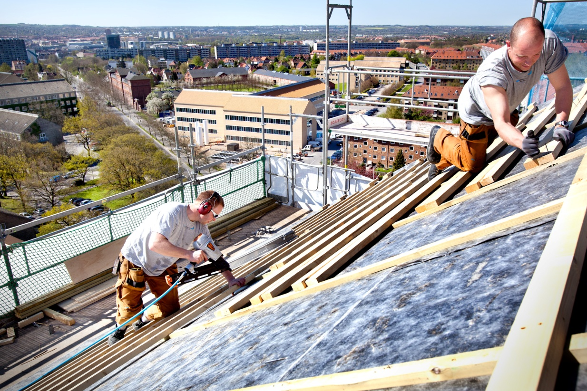
2012 SUMMER ASSEMBLY
AARHUS
UNIVERSITY

Slide 2
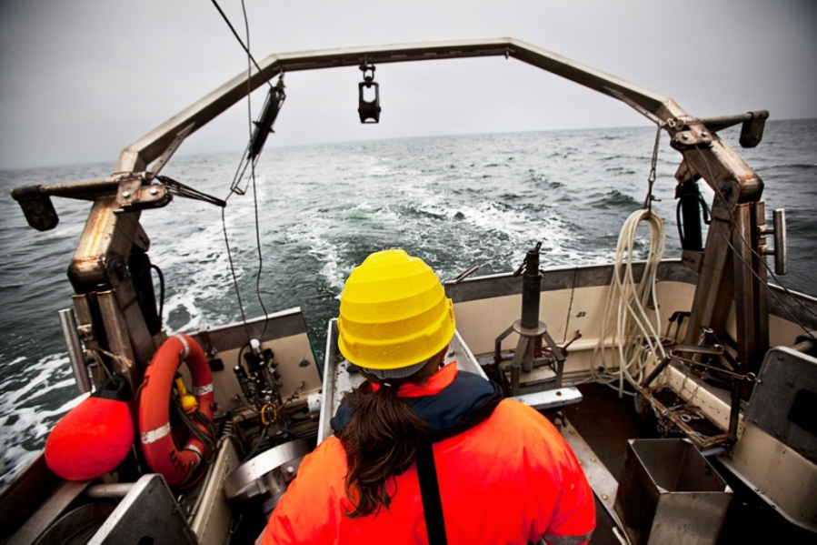
Interdisciplinary research
Interdisciplinary research: a central element in the future organisation of research at AU
Anders Børglum, Søren Rysgaard and Lotte Meinert have just presented their promising research – all are involved in projects which were launched as a result of of the academic development process in 2011

Slide 3
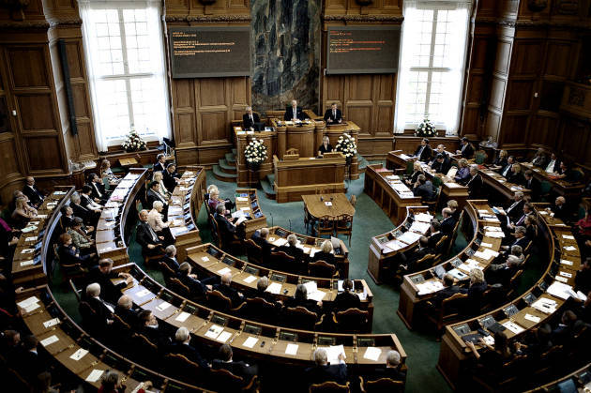
The role of the universities in society
The role of the universities in society is changing: increasingly, Denmark, Europe and the world demand knowledge and insight
The universities are a cornerstone of the knowledge society of the future

Slide 4
Global challenges
Our world faces major changes as a consequence of observable conditions in global development:
Population pressure
Resource scarcity
Epidemics and pandemics
Instability and security conditions
Climate change
Complex, interrelated challenges which require solutions across traditional research fields and academic disciplines

Slide 5
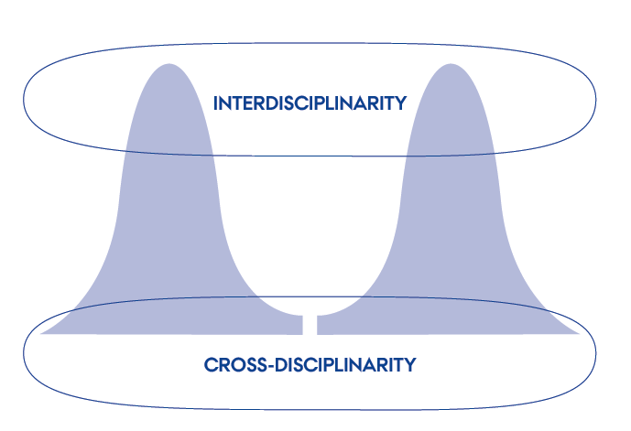
Excellence within and across the core disciplines
Collaborative effort is an aspect AU has emphasised in the preamble of the ambitious new Aarhus University development contract with the Ministry of Higher Education
The university's activities will continue to rest on a foundation of excellence within the core disciplines
While combining these core disciplines in new interdisciplinary partnerships, in a close, flexible interplay with our society

Slide 6
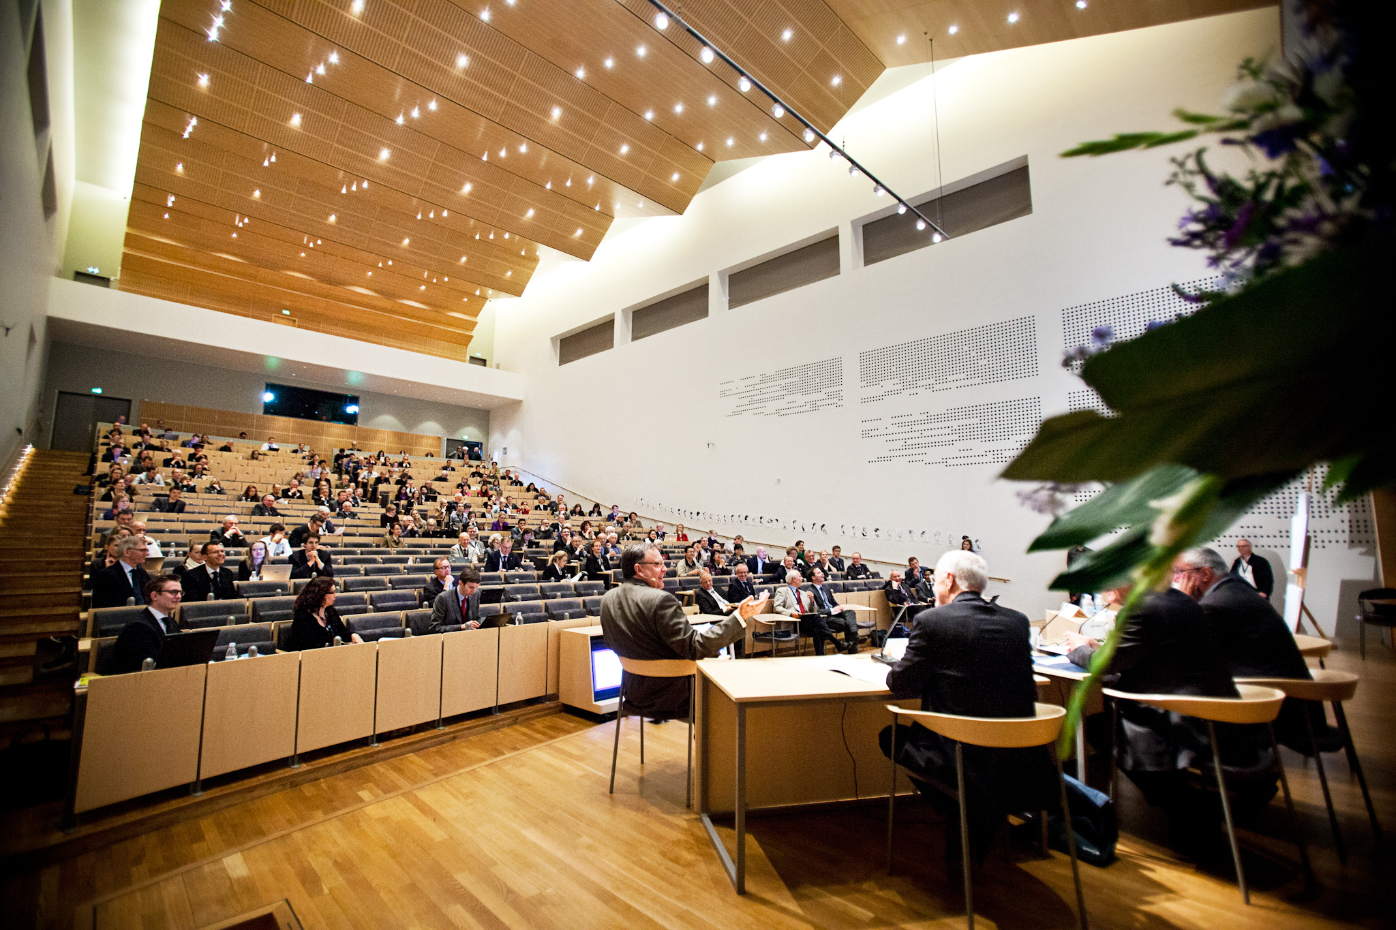
ADSKILLELSE
MED BILLEDE

Slide 7
HORIZON 2020
The European Commission's new framework programme for research and innovation will equip Europe to tackle major social challenges
EU's growth strategy: part of the Europe 2020 strategy
Budget framework: EUR 80bn (DKK 600bn)
Three fundamental principles:
Excellent Science
Industrial leadership
Societal challenges

Slide 8
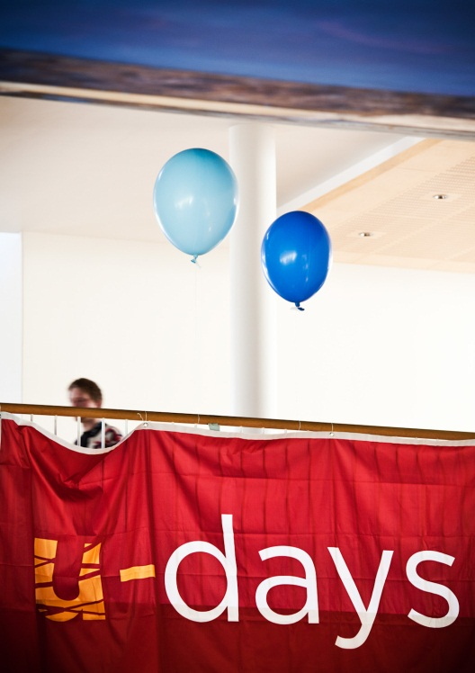
The Danish government's platform: the 2020 plan
Education
95 per cent to complete an upper-secondary education
60 per cent to complete a post-secondary degree
25 per cent to complete a post-secondary degree
2.5 per cent to complete a doctoral degree
Better post-secondary degree programmes
Decreased time-to-degree
Coherent structure and smoother transitions between levels in the educational system
Research and innovation
A minimum of one per cent of BNP to be invested in research
Improvements in innovation capacity

Slide 9
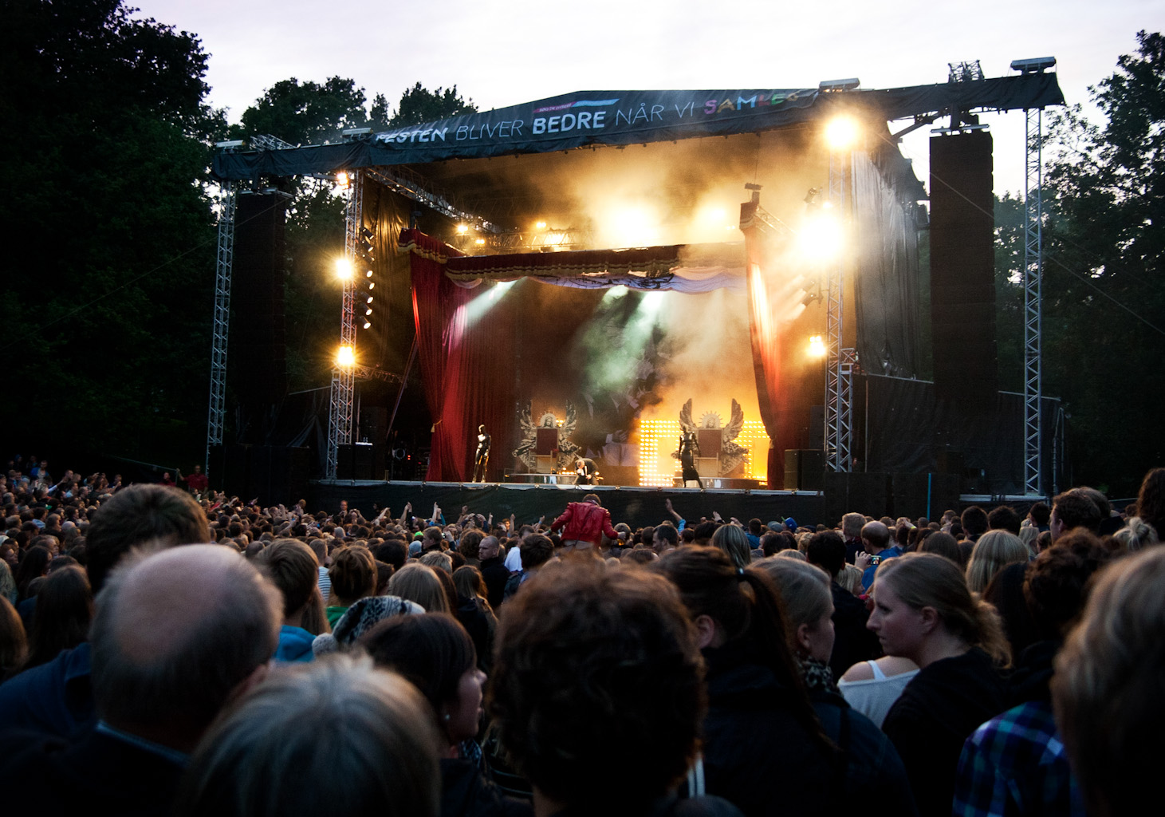
ADSKILLELSE
MED BILLEDE

Slide 10
Our foundation - our challenges - and AU's solutions
The Ministry's supervisory report (2012) provides a solid foundation for the coming years
The new development contract (2012-2014) is complete:
Contains a range of concrete goals for our future development
Aarhus University updates its strategy (2012-2017)
Not a decisive shift in strategic direction
A sharper definition of goals and the activities and initiatives required to achieve them
The strategies of the main academic areas are in consultation and to debate - a process which will continue throughout the autumn

Slide 11
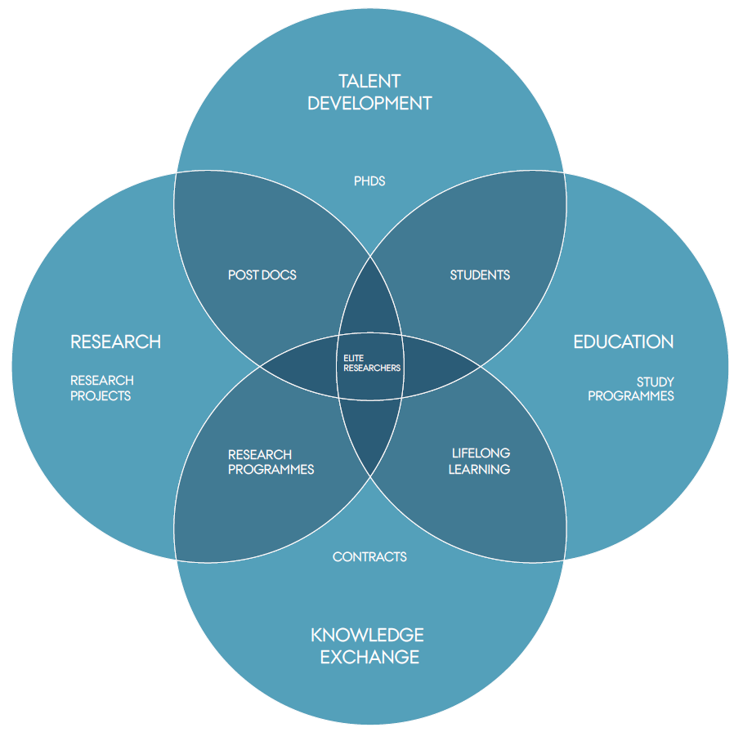
Clearer challenges
The university's current strategy has been focused on implementing an academic and administrative structure which provides a good foundation for addressing society's challenges
The new development contract will supplement existing strategies by identifying concrete goals for a few selected areas
The total palette of goals provides a broad picture of the university's activities

Slide 12
Increased competition in the world of research
More funding must be acquired through external competition
AU's solutions:
Researchers must submit more collective applications in larger groups
Networks and consortium agreements with researchers from other universities
Strengthened research support services
Researchers are becoming increasingly mobile
AU's solutions:
Focus on developing our own research talents
Recruit prominent researchers and retain the most talented junior researchers
Develop transparent, coherent career paths for all employees and implement a well-functioning tenure track model for academic staff

Slide 13
Knowledge for society
Focus on the challenges our societies face
AU's solutions:
Interdisciplinary initiatives
Annual revenue 2014 projected at DKK 275m
Continued provision of independent research-based advisory and scientific services
AU's solution:
Establishment of national centres in fields where AU possesses particularly relevant expertise in relation to society's needs
New incentive structure and professional recognition for participating researchers

Slide 14
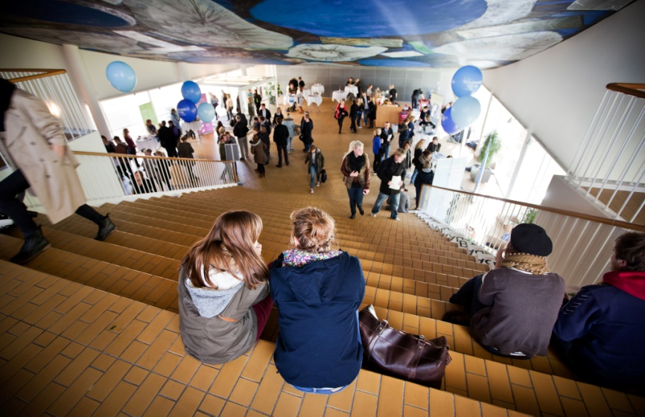
Coherence in the educational system
Ensure coherence in the educational system
AU's solutions:
More effective recruitment
Better opportunities for internal credit transfer - main focus on competences rather than the syllabus
Increased collaboration with other advanced degree programmes at other institutions
Improved opportunities for continuing education across the higher education system
More direct contact with the job market

Slide 15
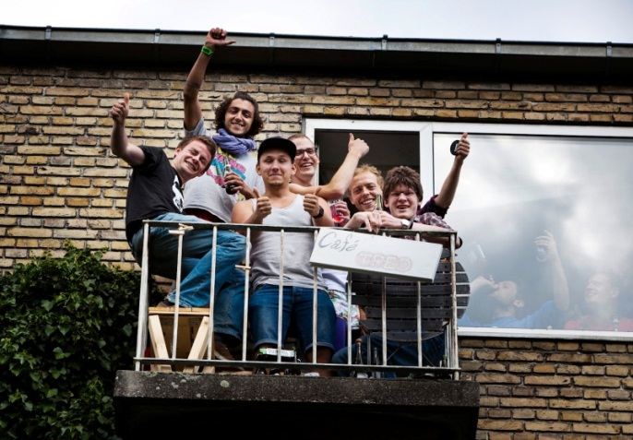
Quality degree programmes
The challenges of the 'mass university'
AU's solution:
Focus on quality, study environment and teaching
development
Research-based teaching and student guidance
Better adaptation to the needs of the job market
Parallel focus on elite programmes for students with an interest in a research career
Ensure that graduates have good employment prospects
AU's solution:
Innovation and entrepreneurship programmes, student jobs, professionally oriented Master's degrees, the Student Entrepreneurship Incubator

Slide 16
Knowledge exchange and innovation
Innovation and effective knowledge exchange in flexible interplay with society
AU's solutions:
Increase the number of industrial PhD students, corporate-sponsored professorships, and partnerships with private businesses
External partnerships worth an estimated DKK 1.3bn in 2014
Contribute to developing the national innovation strategy
Ensure continuing influence on civil society, political decisions and culture
AU's solutions:
Increase further and continuing education, career services and alumni activities
Exploit synergies between activities - including links to the business community

Slide 17
Major changes and open debate
The most comprehensive reorganisation in the university's history continues, and in the last si months, it has given rise to many critical questions, comments and proposals
While public debate has been sparked by these changes, it has often focused on more general issues of university policy
The debates closes to the development process itself have most often concerned the level of administrative service
On the university website, University Director Jørgen Jørgensen provides a status report on the administrative situation: great efforts are being made to bring the organisation into place as quickly as possible

Slide 18
The Ministry's conclusion in the 2012 supervisory report
'Aarhus University is contributing to addressing major social challenges and has pledged to contribute actively to fulfil its role as one of the cornerstones of the knowledge society. In response to these challenges, a range of necessary organisational changes have been implemented. As of 1 January 2011, Aarhus University implemented a new academic organisation. This represents a major reorganisation which is still ongoing and which has not yet been evaluated. The evaluation will be included in the psychological workplace evaluation to be performed in 2012.' (p.7)
'This report represents Aarhus University as a well-functioning university which exhibits positive development in all of its core activities and with respect to the enhancement of its physical surroundings
Generally speaking, Aarhus University fulfils the requirements and follows the guidelines which have been laid down for Danish universities.' (p. 61)

Slide 19
Thank you for your commitment
The university has sat ambitious goals for itself, and we are aware that great demands are being placed on the organisation
We are working to solve the problems and ensure the university's continued development and the well-being of its staff
The considerable progress we are experiencing - under difficult working conditions for many - would not be achieved without dedicated, competent employees
A warm thank you for all your hard work!

Slide 20
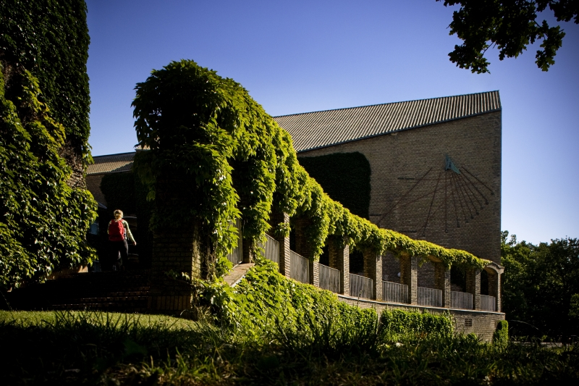
AN EXCELLENT SUMMER TO YOU ALL
AARHUS
UNIVERSITY
RECTOR LAURITZ B. HOLM-NIELSEN

