Slide 1
Aarhus University
We create value through knowledge, new insight and collaboration
Notes:
HUSK AT ”AKTIVERE INDHOLD” I DIALOGBOKSEN DER KOMMER NÅR PRÆSENTATIONEN STARTER (GUL BJÆLKE)

Slide 2
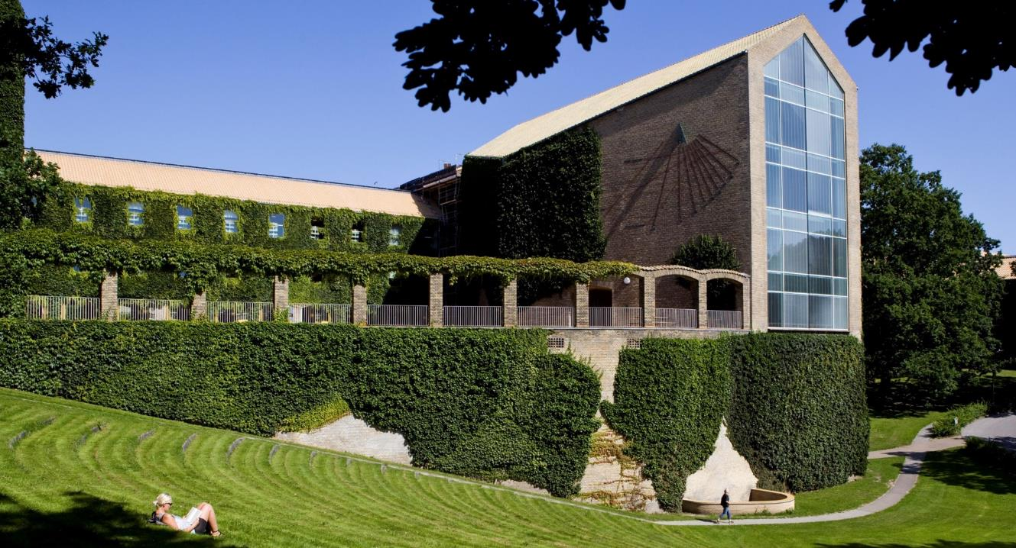
Aarhus University
in three minutes
Notes:
FILM KOMMER EFTER KLIK

Slide 3
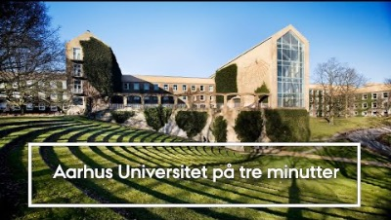
Notes:
FILM KOMMER AUTOMATISK
(Vær klar til at klikke videre når filmen er slut, for at undgå reklameslides fra YouTube)

Slide 4

Facts about
Aarhus University

Slide 5

Rooted in a broad palette
of strong disciplines
5
faculties
36,500
students
11,500
employees
1,900
PhD students
Notes:
[Photo: The arches at Solgården (‘The Sun Courtyard’)]
Aarhus University is a strong university that is internationally recognised for the high quality of its research, research-based degree programmes and public sector government consultancy, in addition to value-creating collaboration with private businesses, public sector institutions and civil society.
Aarhus University’s academic portfolio is broad-ranging, from the classic university disciplines of the humanities, natural sciences, social sciences, health sciences and theology to business and engineering, educational theory and practice and the environmental and agricultural sciences. This breadth gives the university a unique opportunity to combine strong disciplines in the creation of research breakthroughs, and to establish close collaboration with many sectors to the benefit of society as a whole.

Slide 6
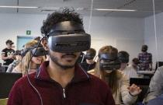
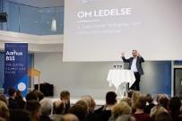


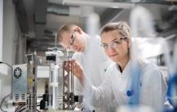
Research-intensive
and a full breadth of disciplines
Faculty of Arts
Aarhus BSS
Health
Faculty of Natural Sciences
Faculty of Technical Sciences
Humanities, theology, educa-tional theory and
education
15%
Business and social sciences
18%
Health sciences
27%
Natural sciences
17%
Agricultural and environmental
sciences and engineering
23%
Notes:
The table shows the percentage of staff employed at each of the five faculties.
Arts: 15%
BSS: 18%
HE: 27%
NAT: 17%
TECH: 23%
I alt = 100%

Slide 7
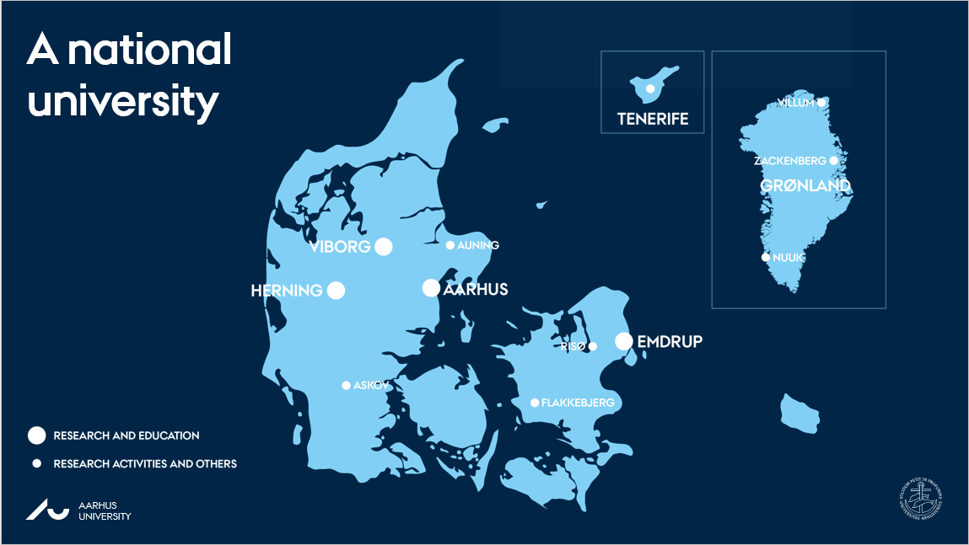
Notes:
From its early days as a local university, Aarhus University has developed into a globally recognised university, with international standing and impact, to the benefit of both the individual and Danish society.
The map shows where AU has research and/or educational activities:
Aarhus
Emdrup
Viborg (Foulum)
Flakkebjerg, Sydsjælland
Askov, Sønderjylland
Risø, v. Roskilde
Herning
Auning, Norddjursland
Grønland (Nord: Villum Research Station, Midt: Zackenberg Research Station, Syd: Nuuk / AU Arctic Research Centre)
Tenerife
[The map is updated in May 2023]

Slide 8
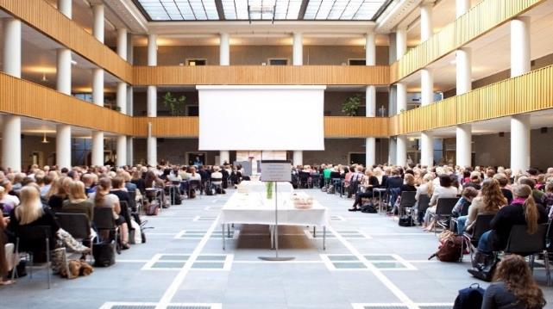
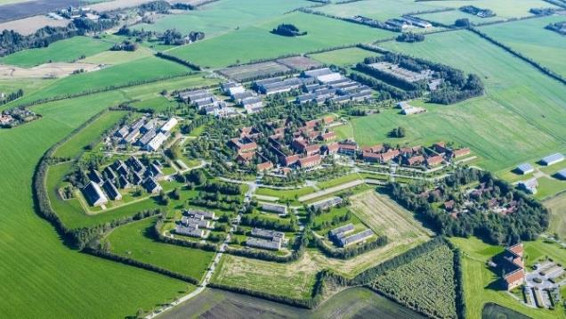
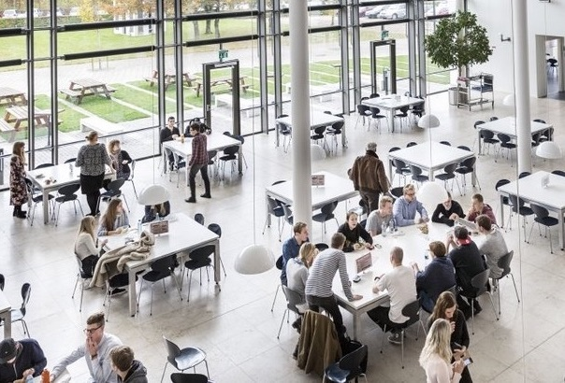
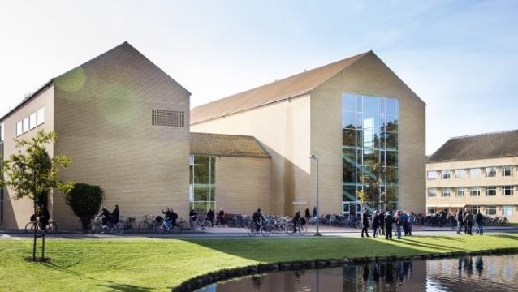
One university –
four campuses
Emdrup
Viborg
Herning
Aarhus
Notes:
Aarhus University has campuses in Emdrup, Herning and Aarhus, and soon Foulum (2024).
[This picture shows: Emdrup Campus (the main hall), AU Viborg (Foulum), AU Herning (the canteen) and Aarhus Campus (the back of the Lakeside Lecture Theatres)]

Slide 9



International collaborations
As a member of international alliances and networks,
AU contributes to the global exchange of knowledge and talents.
Notes:
The need to work together to find solutions to global societal challenges is greater than ever before. We contribute to an increased global exchange of knowledge and talents through AU’s international collaboration.
Membership in international alliances and networks for research, education and collaboration helps to strengthen AU'S global position and connections.
Circle U. is a strong alliance of seven major European universities. The alliance works to facilitate internationalisation and create new connections between research, teaching and innovation. Circle U. is part of the EU’s European Universities Initiative.
https://medarbejdere.au.dk/strategi/internationale-alliancer/circle-u
The Guild
Founded in 2016, The Guild comprises twenty-one of Europe’s most distinguished research-intensive universities in sixteen countries, and is dedicated to enhancing the voice of academic institutions, their researchers and their students. The Guild is committed to the pursuit of excellence, the importance of truth-seeking and trust-building as the foundation of public life, and the creation of new knowledge for the benefit of society, culture, and economic growth. https://www.the-guild.eu/about/
Coimbra Group
Founded in 1985 and formally constituted by Charter in 1987, the Coimbra Group is an association of long-established European multidisciplinary universities of high international standard. The Coimbra Group is committed to creating special academic and cultural ties in order to promote, for the benefit of its members,
internationalisation, academic collaboration, excellence in learning and research, and service to society. It is also the purpose of the Group to influence European educational and research policy and to develop best practice through mutual exchange of experience. https://www.coimbra-group.eu/

Slide 10


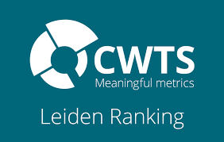



International recognition
AU is among the 25 best universities in the EU
– and is ranked in the top 100 and top 150 by several world rankings
Notes:
AU in the rankings
A number of internationally recognised world rankings evaluate the world’s universities in relation to each other. Among more than 17,000 universities worldwide, Aarhus University is ranked in the top 100 and 150 in several rankings, and AU is in the top 25 of all universities in the EU.
AU scores particularly high on research quality and education. With regard to internationalisation, AU also ranks among the best of the world's universities, with a position as no. 45 on the Most International Universities in the World ranking.
Aarhus University is particularly focused on six of the leading world rankings. This is due to these rankings’ transparent, rigorous methods, as well as the relevance of the indicators they use. The rankings assess parameters including the quality of research, the quality of the degree programmes and the reputation of the universities. The indicators and methods used by the different rankings vary.
https://www.au.dk/om/profil/ranking

Slide 11
Allocation of AU’s revenue
(AU’s revenue: DKK 7,3 billion)
Notes:
Aarhus University receives its revenues from five different primary sources:
Government funding for education and basic research, in other words the appropriations in the annual Finance Act.
External funding from both private and public foundations. External grants accounts for around 32 per cent of total income.
Public sector consultancy refers to framework agreements to provide science advice to government agencies and institutions, ministries and the like. Public sector consultancy contracts include sector-specific research and forensic medicine, exclusive of special contracts with the Ministry of Environment and Food of Denmark
DKK 2.57 billion from external funding
DKK 1.98 billion from basic research
DKK 1.79 billion from education
DKK 0.37 billion from public sector consultancy
DKK 0.51 billion from other
DKK 0.09 billion from other Finance Act Grants

Slide 12
Strategy 2020-2025
Aarhus University

Slide 13
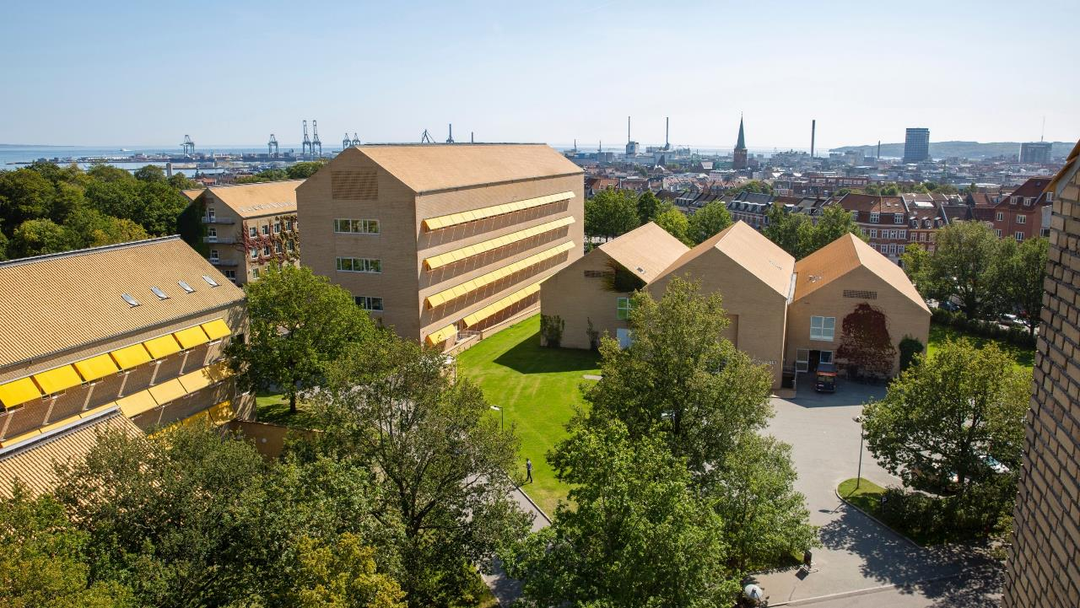
Strategy 2020-2025
Values
Aarhus University safeguards freedom of research and expression, in addition to individuals’ opportunities to realise their potential. Open dialogue, tolerance and diversity are the very foundation of the university’s vocation. Because we regard the universities as one of the pillars of society, we assume co-responsibility for the
development of a democratic, sustainable society.
Notes:
[This picture shows the Skou Building and the Steno Museum]

Slide 14
Strategy 2020-2025
Vision
Aarhus University’s vision is to be a research-intensive university that aspires to the highest international quality and excels in creating value through knowledge, new insights and collaboration,
connecting Denmark and the world.
Notes:
Aarhus University’s vision is to be a research-intensive university that aspires to the highest international quality and excels in creating value through knowledge, new insights and collaboration, connecting Denmark and the world. Aarhus University’s vision for 2025 will be realised through a focus on the following strategic commitments:
Generating knowledge and research breakthroughs through free, independent research of the highest international quality
Research-based degree programmes of the highest international quality
Performing impartial public sector consultancy services of the highest international quality
Encouraging the university’s students, graduates and researchers to bring their knowledge into play in order to shape the society of the future
Contributing to international collaboration, global engagement and the solution of major societal challenges through interdisciplinary research collaboration
Generating innovation in established public and private sector companies and startups through collaboration, both internally and with external partners
Intensifying the exchange of talents and knowledge, locally, nationally and globally.

Slide 15
Strategy 2020-2025
Mission
Notes:
Three core areas: Research, Education and Collaboration.
With Strategy 2025, we will take the development of a truly international campus university even further.
We will reach even higher levels of excellence in research and education, increase our impact on society and continue to develop our campuses
in order to provide a framework for an inclusive, academic, research and work environment of the highest international
standard. We will support the university's core activities with high-quality administrative support functions
with a high focus on digital solutions and sustainability.
In Strategy 2025, we stress the importance of the university’s role as one of the pillars of our society. We have a special responsibility to connect Denmark to the rest of the world, to intensify our engagement with external partners, to contribute to a well-informed democracy and to put human actions and concerns into perspective.
We will anchor our work towards these goals in the inclusive community of the campus experience.

Slide 16
Research at
Aarhus University

Slide 17
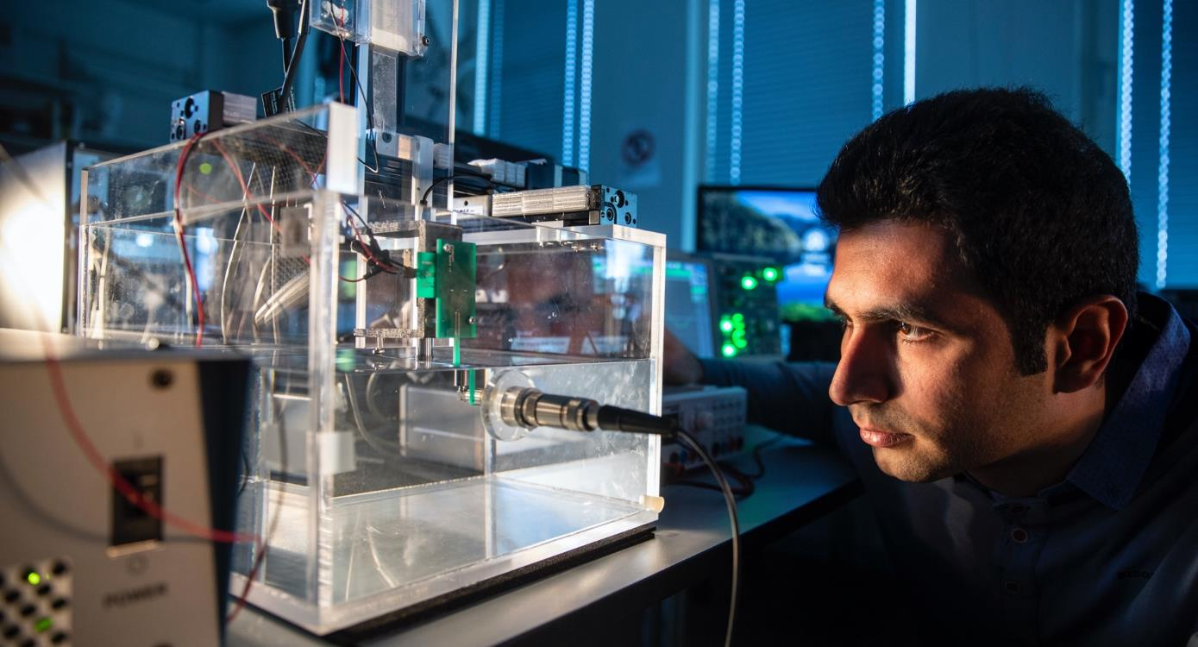
We create insight and knowledge
100 research centres at five faculties
12,000 publications annually
Five exceptional graduate schools with 1,900 PhD students
AIAS – excellence in basic research and talent development
Two Nobel Prizes
Notes:
[This picture shows a member of academic staff from the Department of Electrical and Computer Engineering, who is conducting research on the interface between electronics and the human brain]
AIAS: Independent, curiosity-driven research carried out by top researchers from all disciplines characterises Aarhus Institute of Advanced Studies. AIAS focuses exclusively on research expertise and cultivating research talents.https://aias.au.dk/
Nobel Prizes:
A Nobel Prize was awarded to an AU researcher for the first time in 1997. The recipient was Professor Jens Christian Skou, now deceased, and he received the prize for his work on the sodium-potassium pump.
In 2010, Niels Bohr Professor Dale T. Mortensen (b. 2 February 1939 - d. 9 January 2014) was awarded the Nobel Prize in Economics together with Christopher A. Pissarides and Peter A. Diamond.

Slide 18

We create value through knowledge
Three special interdisciplinary research initiatives
SHAPE
Shaping Digital
Citizenship
Highlighting active citizenship and democracy in a digital age.
START
Centre for Sustainable Agrifood Systems
Developing the solutions of the future for the green transition within agricultural and food systems.
PIREAU
Platform for Inequality Research at Aarhus University
Exploring inequality
and strategies for combatting it.
Notes:
[This picture shows the main pedestrian street in Aarhus]
SHAPE: https://shape.au.dk/en/
START: https://start.uni.dk/
PIREAU: https://pireau.au.dk/

Slide 19
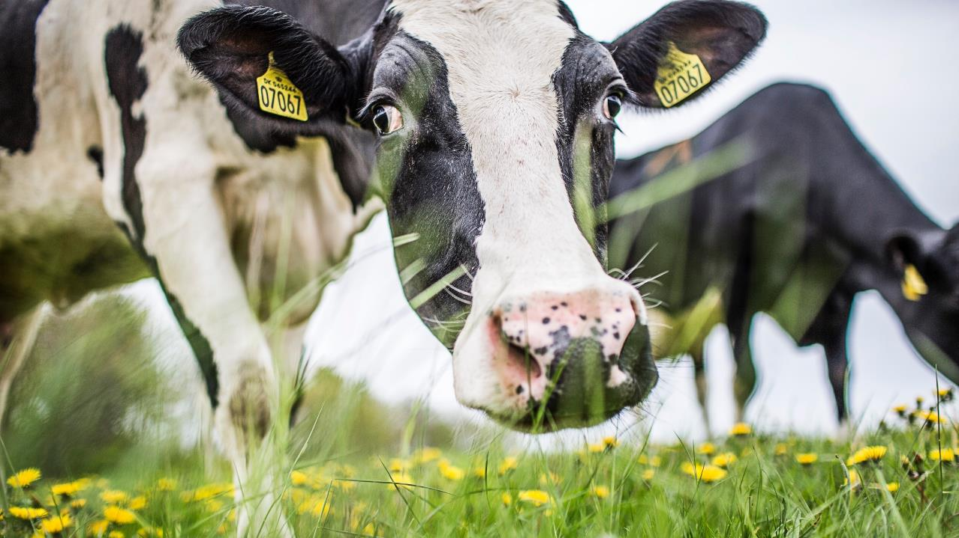
Accelerating the green transition
Three research initiatives centred on climate-friendly energy
LAND-CRAFT
Pioneer Center for Landscape Research in Sustainable
Agricultural Futures
Developing basic research-based solutions for the green transition in agriculture.
CORC
The Novo Nordisk Foundation CO₂
Research Center
Catalyst for cross-disciplinary collaboration to reduce the amount of CO₂ in the atmosphere through researching and implementing new technology.
START
Centre for Sustainable Agrifood Systems
Developing the solutions
of the future for the green transition within agricultural and food systems.
Notes:
[This picture shows cows grazing on a field in Foulum]
LAND-CRAFT: https://land-craft.dk/
CORC: https://corc.au.dk/
START: https://start.uni.dk/

Slide 20
Education at
Aarhus University

Slide 21
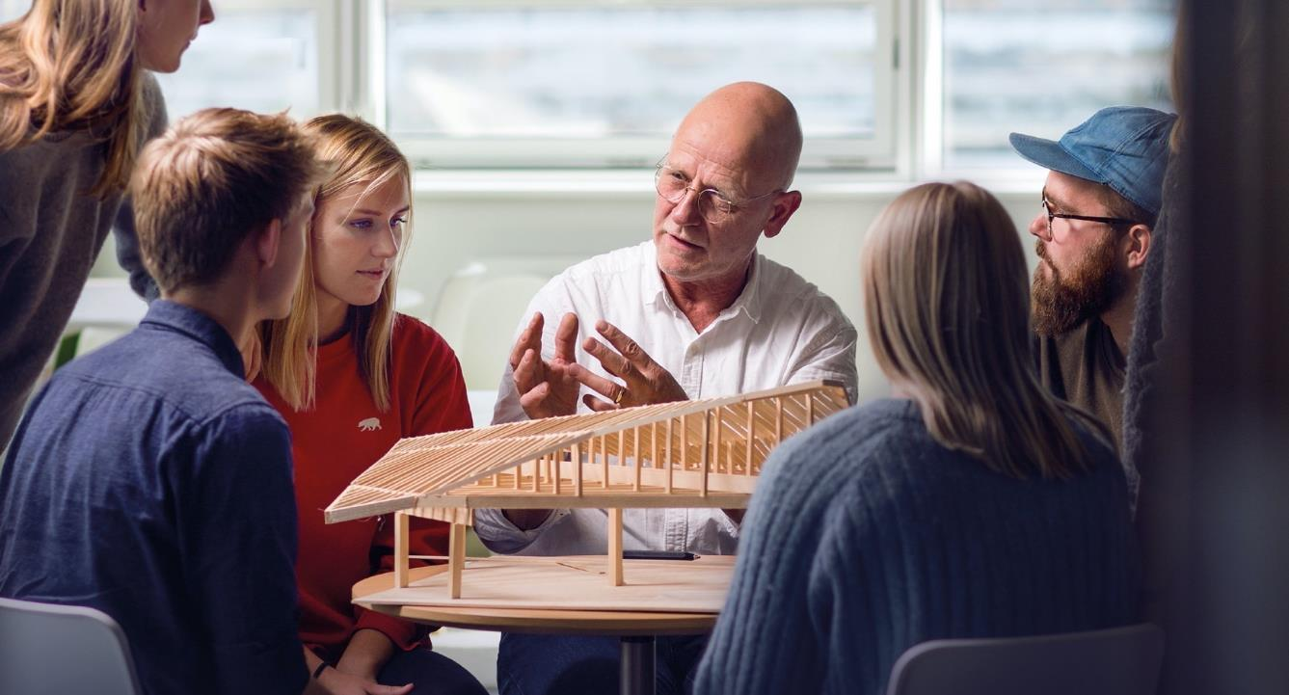
In-depth knowledge and an engaging learning environment
Approx. 6,500
new bachelor
students every year
90
degree programmes
4,400
courses
Notes:
[Photo: Associate Professor Morten Knudsen from the Aarhus University School of Engineering teaching architectural engineering to a group of students]
It is crucial that AU’s degree programmes are characterised by disciplinary excellence as well as an engaging learning environment. Our graduates make important contributions to society. By offering degree programmes at the highest international level, we want to help our graduates develop themselves both academically and personally and to acquire the skills associated with a formative university education. We want our graduates to become responsible citizens of society, who, with their knowledge, independence, curiosity, drive and reflection are able to excel professionally, create attractive jobs and contribute to an enlightened society.
Aarhus University's policy for educational quality assurance: https://medarbejdere.au.dk/strategi/kvalitetspolitik
https://bachelor.au.dk/

Slide 22
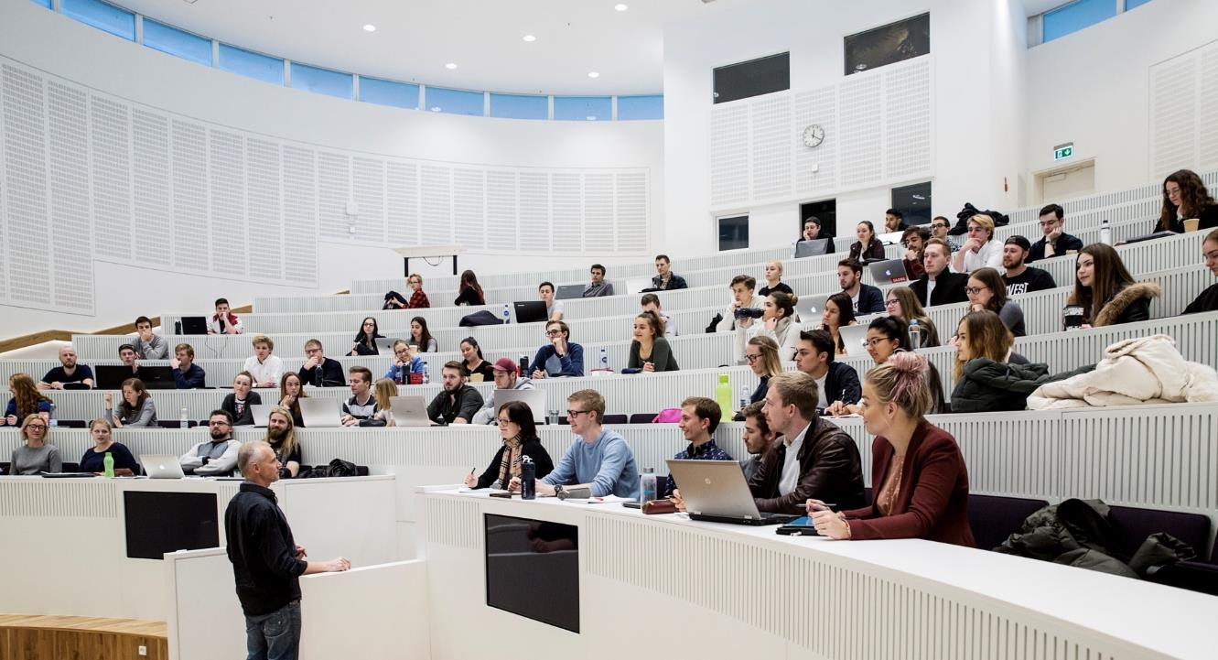
Graduates are our most important contribution to society
5900
no. of graduates
per year
9 out of 10
are employed within two years of graduation
92%
of surveyed companies are satisfied with their collaboration with students from AU
9/10
Are satisfied with the quality of their education
Notes:
[This picture shows a lecture at AU Herning]
Total number of graduates of Master’s degree programmes and and professional Bachelor’s degree programmes from Aarhus University 2022: 5869
The total number of graduates includes graduates of Master’s degree programmes and and professional Bachelor’s degree programmes, the two groups of graduates with a well-defined job market.
(Professional Bachelor grads 841) + (Master’s grads incl. programmes for working profesionals 5,028)
_______________________________________________
92% of surveyed companies are satisfied with their collaboration with students from AU
9/10 are satisfied with the quality of their education
These figures are from the study environment survey: https://studerende.au.dk/studieundersogelse/studiemiljo2020
__________________________________________________________________
9 out of 10 grads are employed within two years of graduation
Figures for unemployment are from the graduate survey/from PowerBI
https://kvalitet.au.dk/aarhus-universitet/staerke-kandidater-med-relevante-kompetencer/dimittendundersoegelse

Slide 23
Student life at
Aarhus University

Slide 24
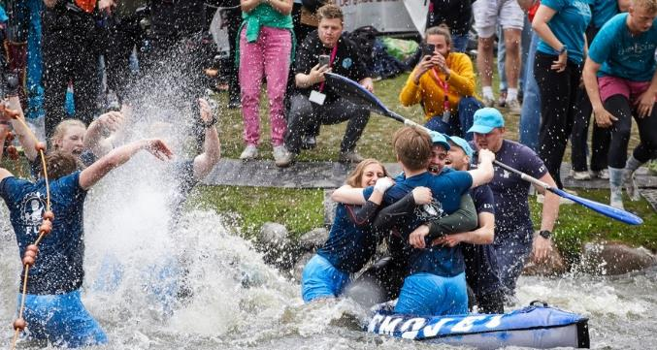
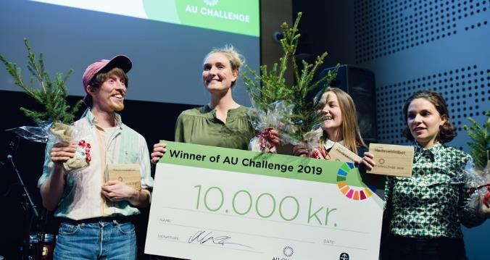
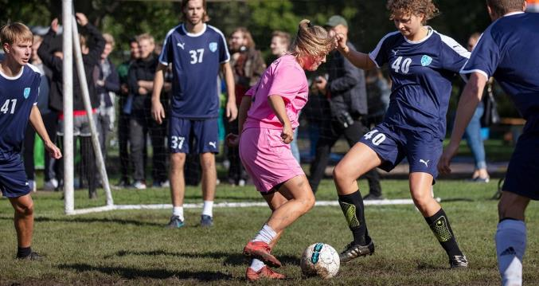
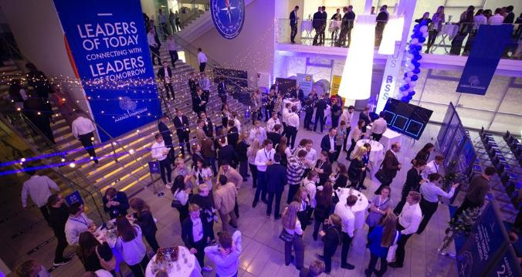
Aarhus named Denmark’s best university town
The Regatta
AU Challenge
Sports Day
Aarhus Symposium
Notes:
STUDENT LIFE AT AARHUS UNIVERSITY
Aarhus University’s campuses invite and foster student life, both socially and academically. We are currently expanding our main campus. Centrally located in Aarhus, it is a hub for vibrant student life and offers excellent facilities that integrate teaching and research and promote a modern, flexible environment for learning. There is room for students to grow and explore – first and foremost academically, but also in the many volunteer associations, entrepreneurship and student-organised events, as well as getting to know fellow students from Denmark and abroad and engaging with society.
____________________________________________
For the third year in a row (2023), Aarhus has been named DK's best university town (source: https://www.studentum.dk/aarets-studieby/). This title is awarded based on eight criteria:
Good career opportunities
Academic excellence
Sense of security
Cheap housing
Student jobs
Good transportation system
Cultural, athletic and recreational activities
Quality of life
_______________________________
The Regatta
This annual event, at which different student associations from AU and other educational institutions in Aarhus compete for ‘the Golden Bedpan’, is probably northern Europe's largest student event.
The event takes place in the University Park and attracts thousands of students from all over the region.
Aarhus Symposium
At the student-organised Aarhus Symposium in November, students have ample opportunities to engage in debate and discussion on the year’s theme and network with representatives from a wide variety of Danish and international companies.
Case competitions
AU Challenge is a competition where 200 students from different subjects work together in teams to solve cases for companies.
All of the cases focus on sustainability challenges, and the competition itself is conducted sustainably on the basis of the UN’s SDGs.
Students who participate develop their ability to work across disciplines and enhance their professional networks.
Denmark’s biggest Friday bar and sports day
Every year at the beginning of the autumn semester, ‘Denmark’s biggest Friday bar and sports day’ brings the University Park alive with sporting events, parties and live music.
The day starts with various tournaments, from volleyball to handball and chess and fencing – and ends with concerts and parties.

Slide 25
Collaboration with
Aarhus University

Slide 26
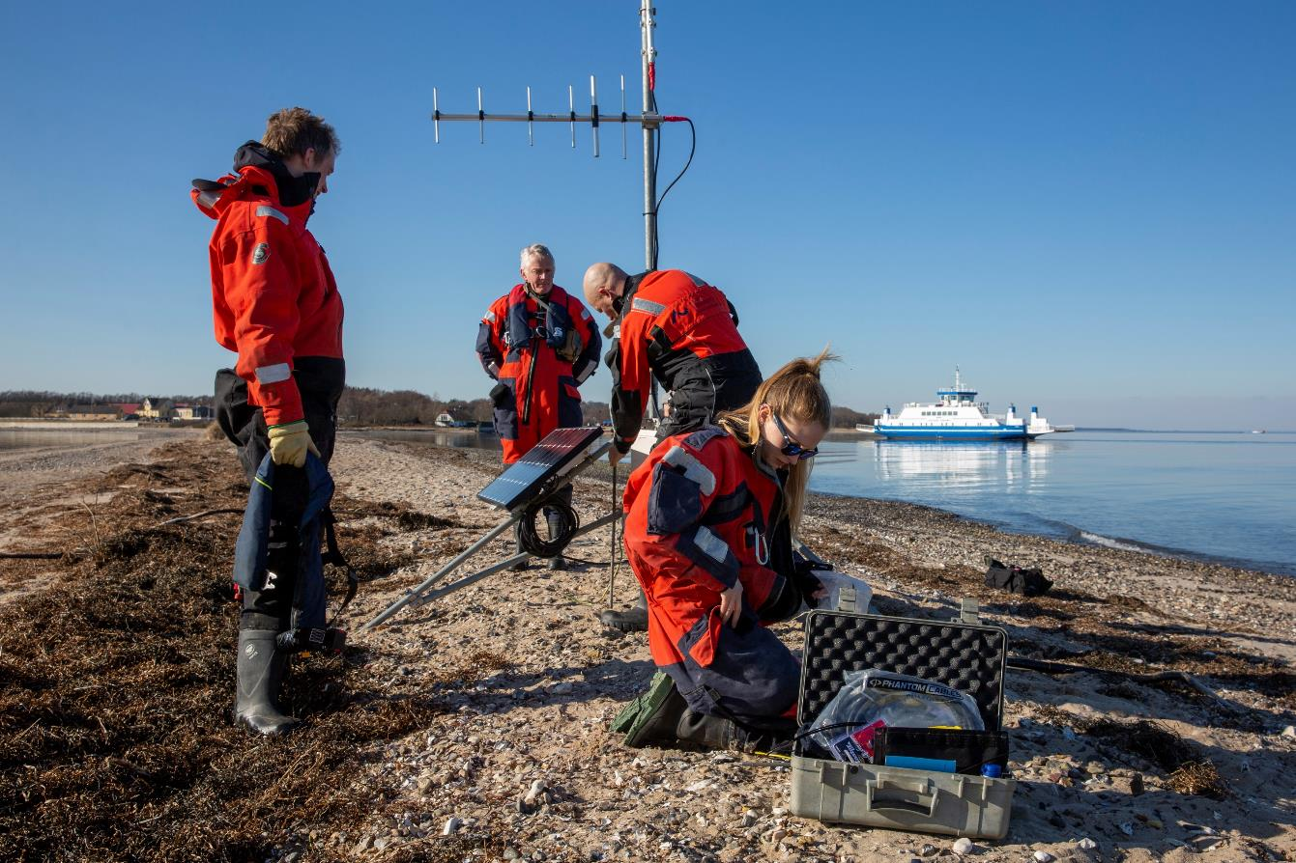
We deliver solutions to society
Approx. 600 collaboration agreements with municipalities, businesses and foundations
Research based science advice to government
Collaboration with upper-secondary schools
Alumni network with approx. 43,000 members
Notes:
[This picture shows researchers from the Department of Ecoscience (TECH) setting up equipment near Sundsøre Odde to receive GPS positions from tagged seals. Havpattedyrforskning/myndighedsbetjening/feltarbejde]
https://www.au.dk/samarbejde/
https://alumner.au.dk/
https://www.au.dk/samarbejde/samarbejde-med-skoler-og-gymnasier

Slide 27
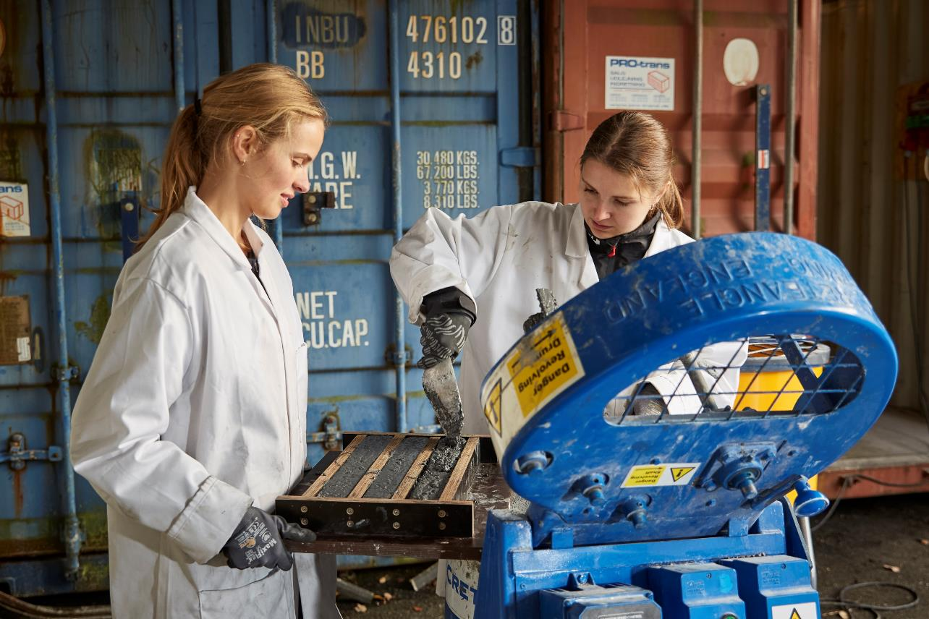
We deliver value to society
... through collaboration and innovation
INNOVATION
AND ENTREPRENEURSHIP
More knowledge-based startups
More entrepreneurial experience
COLLABORATION
WITH EXTERNAL PARTNERS
more value-creating collaborations
Graduates who
create value
STRONGER FOUNDATION
Development of culture
More professional infrastructure
Greater visibility
Notes:
[This picture shows two engineering students who are developing a particular type of concrete for – among other things – terrorism protection]
https://medarbejdere.au.dk/erhvervssamarbejde-og-innovation/

Slide 28
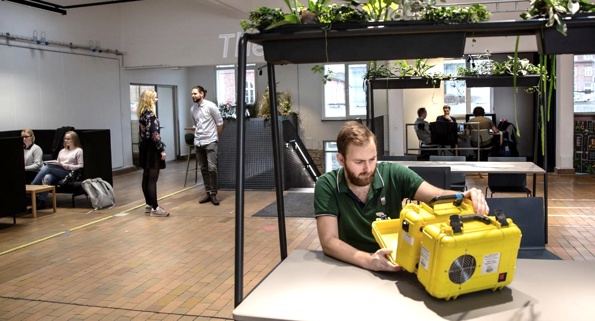
AU gives entrepreneurship a boost in The Kitchen
+50
Annual events
+150
AU startups
and spinouts
Notes:
[This picture shows one of the many inspiring work areas in The Kitchen]
The Kitchen – AU's entrepreneurship building for students and researchers
The Kitchen offers open work spaces and facilities for entrepreneurs, and it hosts a wide variety of open events on entrepreneurship. Students and researchers can get access to advice and funding opportunities, and access to the start-up ecosystem and established businesses in Aarhus.
https://thekitchen.io/
Facts about The Kitchen:
The Kitchen is a new 3,300 m2 entrepreneurship and innovation hub.
It’s located in the old central kitchen of the former municipal hospital in Aarhus, and a lot of details have been preserved, like the tiles on the walls, old hospital equipment and doors you open by pulling on a cord.
The Kitchen has open workstations and offices for students and researchers enrolled in programmes in The Kitchen, and it has its own coffee shop.
The Kitchen has small and large meeting rooms and offers refreshments for meetings.
The Kitchen is open to Aarhus residents and the entrepreneurship ecosystem.
The Kitchen holds open events, talks, crash courses and much more.

Slide 29
Aarhus Campus

Slide 30
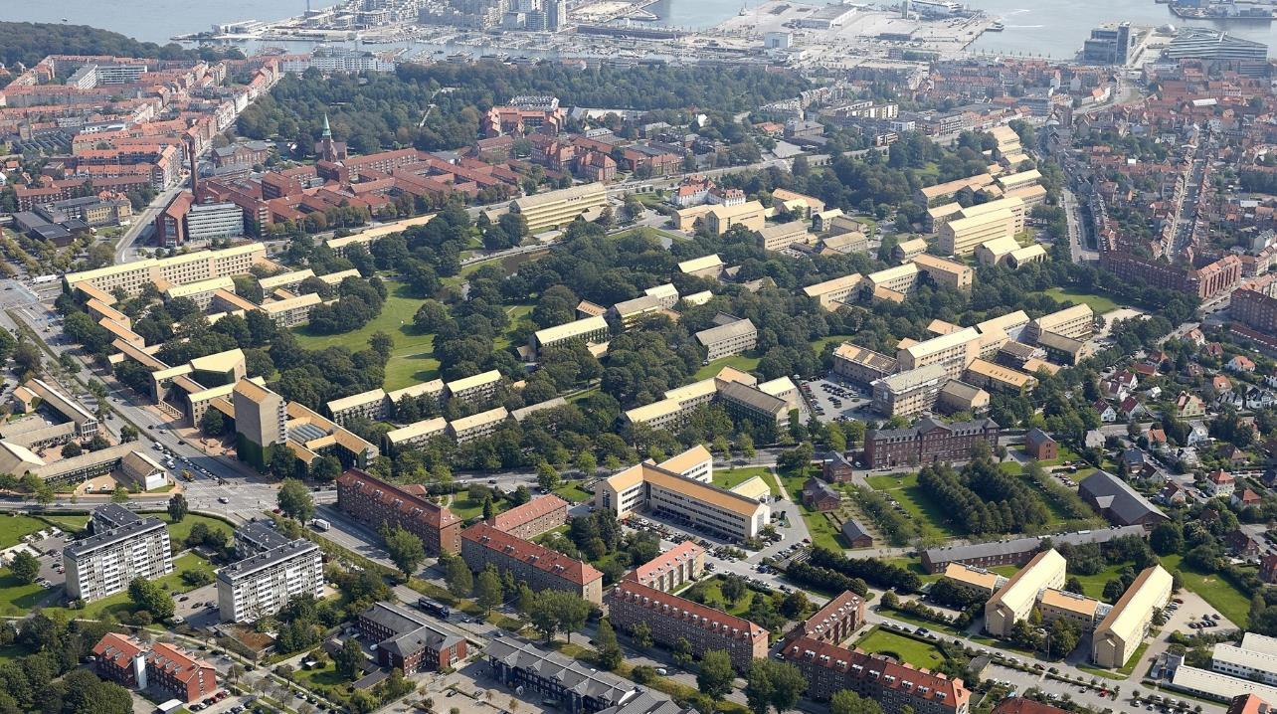
We are continually developing our main campus
Notes:
[BILLEDE: Aerial photo of the University park with the University City (the former municipal hospital) in the background – and Navitas in the top-right corner]
The overall vision for AU’s campus in Aarhus is to develop and strengthen it by consolidating it around the University Park, the University City and Katrinebjerg. Meanwhile, the framework for AU activities outside of Aarhus will continue to be developed , particularly in Foulum, Herning and Emdrup.
The physical development of AU’s campus will ensure that the university can continue to provide an attractive environment for work and study that attracts talented and committed students and staff.
Ten principles for AU’s campus development
Based on the vision, ten overall principles have been developed. The principles will guide the strategic development of the university's campuses in the coming years.
Aarhus University’s campuses must:
promote integration of research and education
promote interdisciplinary research, education and innovation
promote future forms of teaching
be a flexible study environment with many places for study
be an international campus
be able to offer housing to students and researchers
promote collaboration with the business community and the local community
be enhanced by non-university activities
be a car-free area
be developed sustainably.

Slide 31
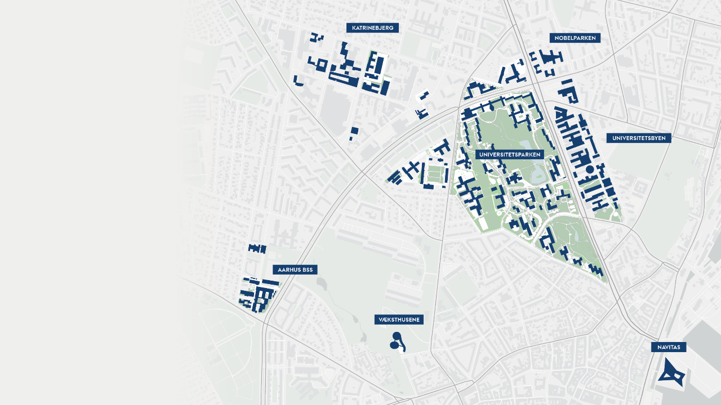
Samlet AU på
et stort areal
Unified AU spans a large area
Notes:
The map shows most of the Aarhus campus as it is distributed around the big roads Nordre Ringgade and Nørrebrogade in 2023.

Slide 32
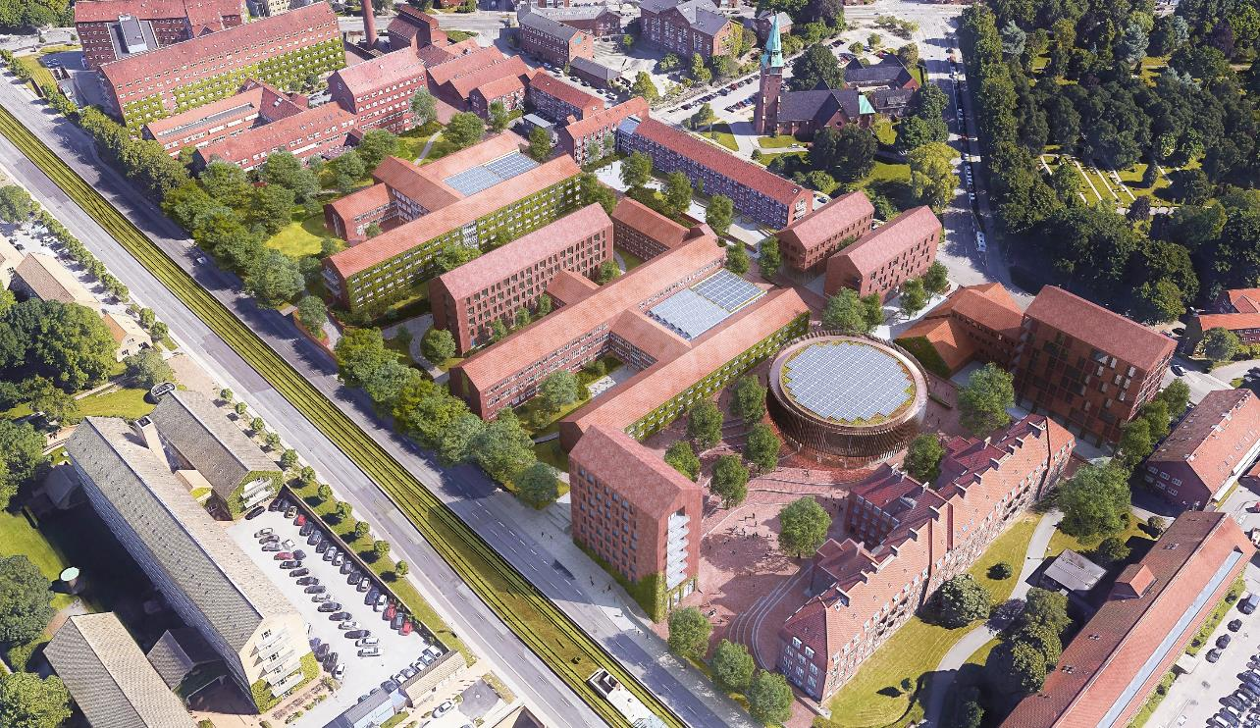
Universitetsbyen
Katrinebjerg
University City
Notes:
Almost 100 years old – and still developing.
Here you can see visualisations of what the buildings of the University City might look like.
https://www.au.dk/om/campus-20

Slide 33
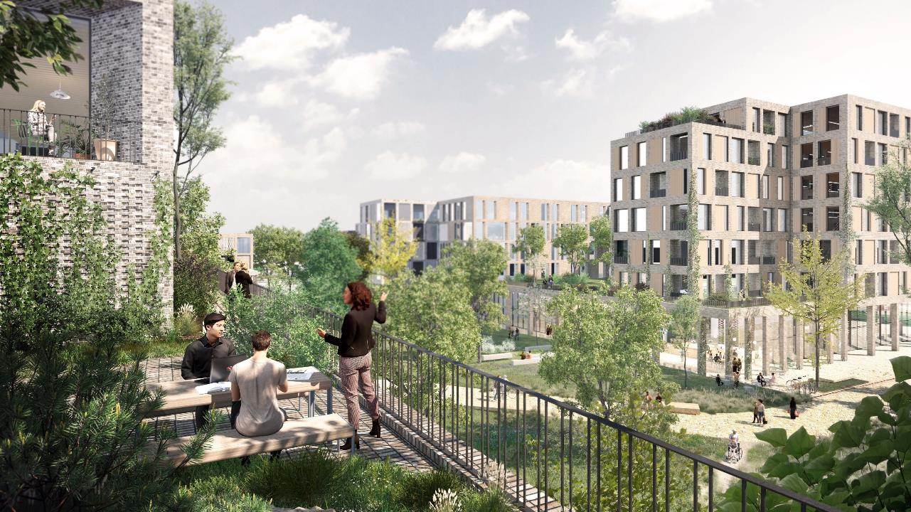
Katrinebjerg
Katrinebjerg
Notes:
Almost 100 years old – and still developing.
Here you can see visualisations of what the buildings of Katrinebjerg might look like.
https://www.au.dk/om/campus-20

Slide 34
Sustainability at
Aarhus University

Slide 35

We are working for sustainable development
AU is contributing solutions to major societal challenges through research and education and is aiming for climate neutrality in 2040.
We are experimenting with sustainability initiatives within four areas:
campus
procurement
transport
waste
Aarhus
University
Notes:
https://www.au.dk/om/baeredygtighed-1

Slide 36
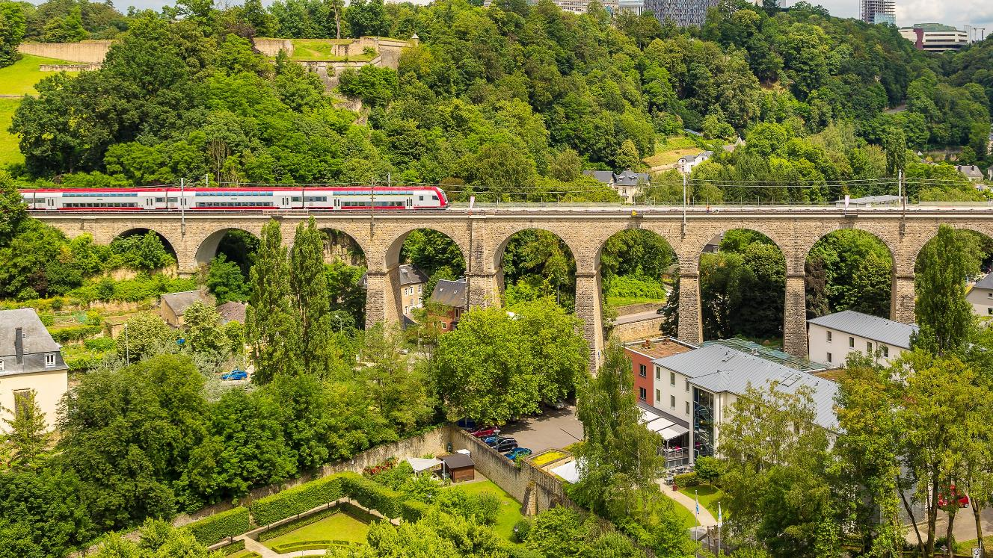
We are experimenting with sustainability initiatives
Travel policy
is reducing AU’s carbon footprint
The climate is a factor in travel choices – for example encouraging online meetings and trail rather than air travel within Europe.
Energy consumption
is being reduced through a joint effort
Focus on lighting, ventilation and heat is helping to reduce the university’s energy consumption.
Vegetarian catering
at meetings and conferences
....is the default choice – meat is an optional add-on. Introduction of more plant-based canteen food is helping to drive AU’s green transition
Notes:
[This picture shows a train travelling across a bridge in Luxembourg]
Examples of sustainability initiatives
AU Green network
AU Garden – Involvement of staff and students in biodiversity
Collaboration between research and operations on energy optimisation in buildings
Research project with solar cells on AU buildings – Crowd-funded by staff
https://www.au.dk/om/baeredygtighed-1

