Slide 1

Toolbox for strategy work at AU
Practical tools managers can use in different contexts in connection with strategy work at the local level.

Slide 2

Contents of the toolbox
Practical guide to strategy work at AU
  Shared situation awareness
  Strategic intent
  Unifying movements
  Short-term to-do lists
  Regular follow-up
Other tools
  Process plan
  Stakeholder analysis
How to use this toolbox
This toolbox is intended to provide practical, actionable support for strategy work at AU.
This material can be used at every stage of your strategy work – whether you’re just getting started on a strategy process or already working with strategy systematically.
Strategy work is broken down into five distinct steps in the material. You can follow all of the steps in order or select the steps that make sense in your context.
Working with strategy is a dynamic process involving ongoing adjustment of local goals and priorities, with Strategy 2030 as the common thread. The toolbox is intended to facilitate the ongoing discussions, decisions and actions that will keep the strategy alive in our day-to-day work.

Slide 3

A practical guide
to strategy work at AU

Slide 4






1
A practical guide to strategy work at AU
Develop a shared situation awareness
What is a strategic direction?
Setting strategic direction is about selecting the most important areas you intend to prioritise and develop in coming years.
A strategic direction doesn’t describe everything your unit does in detail. It identifies a limited number of essential priorities that will guide day-to-day decisions and actions. A typical pitfall is ending up with a general list of tasks rather than a clear ranking of priorities.
Before you begin: clarify your scope and objectives
Define your scope: How broadly does the strategic direction apply? The entire faculty, an entire department, a research group – or a specific theme?
Clarify your objectives: Why are you setting a strategic direction now, and what difference should it make? What opportunities or challenges should it address?
Consider timing: Is there a real need for a strategic direction now – or are there tasks, processes or resources that need to be put in place first?
Decide on the participants: Who will contribute and who will be responsible for the realisation of the strategy? These people, groups etc. should be involved from the beginning to secure buy-in.
Once this has been clarified, you’re ready to get started on your strategy work.
2
Formulate a strategic intent
3
Craft unifying movement statements
4
Make short-term to-do lists
5
Follow up regularly

Slide 5
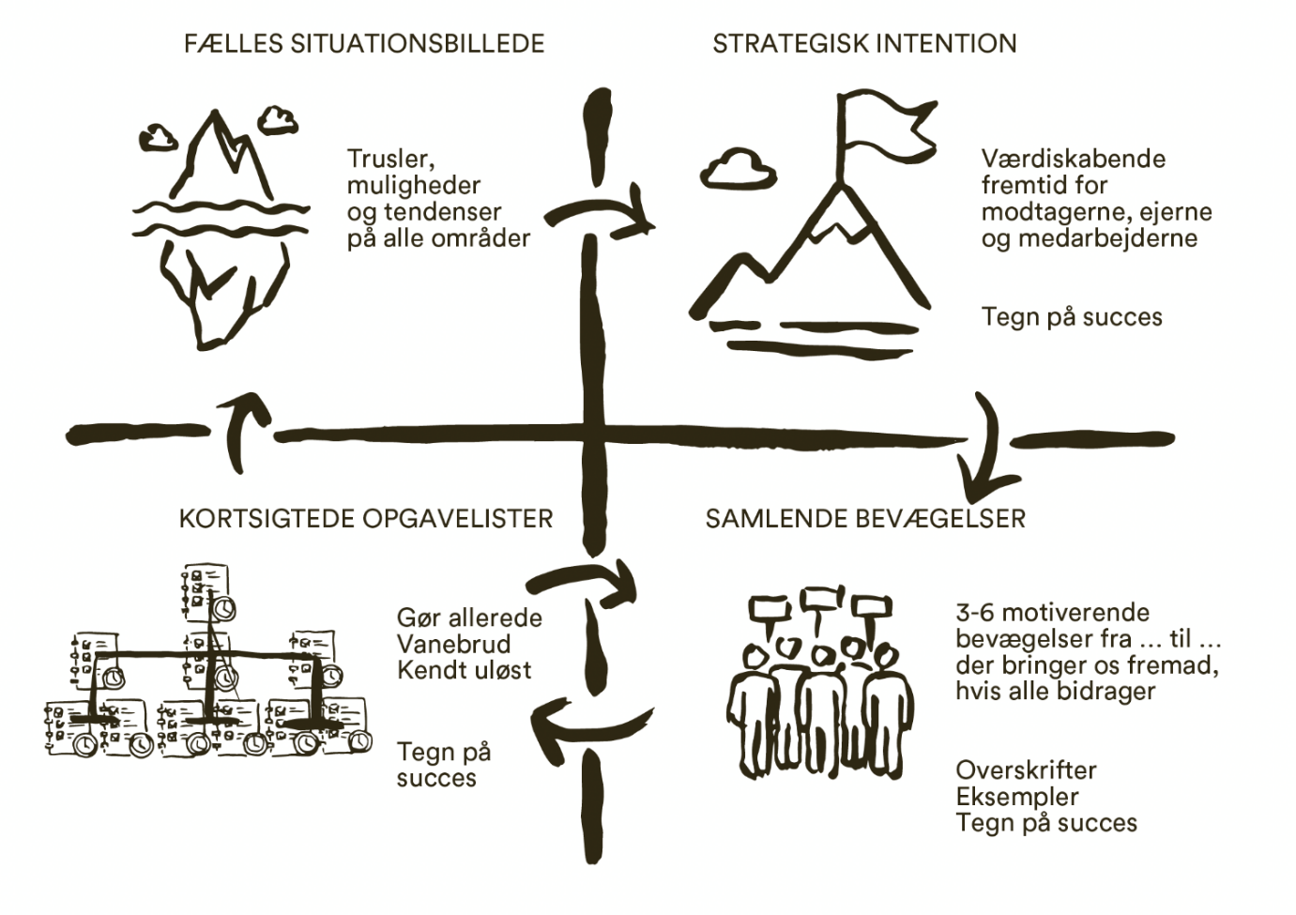
Theoretical framework – organisational movement and mobilisation
The toolbox is based on the strategy realisation method described in the book ‘Much more leadership with the same resources’ by Anders Trillingsgaard (in Danish: Meget mere ledelse med de samme kræfter)
This method understands strategy as a continual movement towards a desired future – the direction is clear, but the path is made by walking.
Strategy work can take place in different parts of the organisation; in other words, strategy can have multiple centres. Units or groups can formulate their own strategic intents that make sense in their context while also contributing to the realisation of the overall strategy.
The next slides present AU’s interpretation of the model along with tips on how to work with it in practice.
s SHARED SITUATION AWARENESS
s STRATEGIC INTENT
Threats, opportunities and trends in all areas
A desirable future scenario for recipients, owners and employees
Signs of success
SHORT-TERM TO-DO LISTS
UNIFYING MOVEMENTS
Already doing
Breaking habits
Known unsolved
3-6 motivational movements from...to...
that will take us forward if everyone contributes
Signs of success
Titles
Examples
Signs of success
Trillingsgaard 2024

Slide 6
1
Shared situation awareness
Develop a shared situation awareness
Definition
A shared situation awareness is a shared understanding of the current situation facing a unit or group – for example key figures, frameworks, challenges and opportunities. Strategy 2030 will always be among the factors to be included in your shared situation awareness.
A shared situation awareness - a shared perception of reality - is developed through dialogue and reflection
The process is just as important as the result, and can be adapted to different organisational levels – for a department, it can centre on data and evaluations, whereas for a team, it might take the form of a discussion of strengths and challenges.
A shared situation awareness is a snapshot that can provide common ground for group discussions about your strategy and direction.
The goal is to:
ensure that everyone shares an understanding of the current situation and acts on the background of this shared understanding.
develop shared perspectives and skills – seeing our situation in new ways opens up new possibilities for action.
create a shared starting point for the strategic intent.
Aarhus
University

Slide 7
1
Shared situation awareness in practice: Programme for a strategy work meeting
Develop a shared situation awareness
Sample agenda (2 hrs.):
Setting the scene: The purpose of the meeting and brief run-through of agenda.
Basis: Review the key points from the preparation and discuss which parts of AU's Strategy 2030 are particularly relevant.
Analysis: Work with SWOT as described on the following slide.
Reflection: Based on your shared situation awareness and the main points from the SWOT dialogue, discuss possible strategic directions.
Embedding: Agree on who needs to buy into the shared situation awareness and how to document it.
Next step: Decide how your work with the strategic intent will continue – jointly or by selecting individuals to write a draft.
The following agenda should be adapted to the size of the group.
Objective:
To reach a shared understanding of the current situation as a foundation for strategic work in the group or unit.
Preparation:
Gather and share relevant knowledge prior to the meeting, e.g. AU's Strategy 2030, key figures for the group/unit, research evaluations, input from employer panels, boards or other external parties, WPA or other relevant data.
Helpful hints
A shared situation awareness provides the greatest value when it is a joint product of the employees who will implement the strategy.
The participants in the process are selected at group/unit level – for example, a leadership team, a team or the permanent VIP/TAP at a department/school.

Slide 8
1
SWOT as a method for developing a shared situation awareness
Develop a shared situation awareness
At your meeting, you can use SWOT as your primary method for facilitating dialogue and a shared understanding of the current situation. The dialogue and reflection are at least as valuable as the end product itself.
Step-by-step:
Step 1 – Strengths and weaknesses
Work individually or in pairs. Reflect on your unit’s/group’s strengths and weaknesses based on your past experiences.
Note down the most important points – one per post-it note.
Colour code: Strengths = blue, Weaknesses = orange.
Share your points with the group and stick your post-its up on a whiteboard or wall. You may want to group them thematically for the sake of clarity.
Step 2 – Opportunities and threats
Work individually or in pairs. Reflect on the current opportunities and threats your unit/group faces.
Note down the most important points – one per post-it note.
Colour code: Opportunities = pink, Threats = yellow.
Share your points with the group and stick your post-its on a whiteboard or wall. You might want to group them thematically.
Step 3 – Group discussion
Review the overall picture of your situation together as a group.
Consider whether there are any holes in your analysis that need to be filled for your situation awareness to be genuinely shared and meaningful.
Internal focus
Strengths
S
Strengths
Weaknesses
W
Weaknesses
Opportunities
O
Opportunities
Threats
T
Threats
External focus

Slide 9
Strategic intent
Definition
A strategic intent articulates a desirable future scenario in the medium term.
It paints a picture of the future you are working towards and is developed on the background of your shared situation awareness.
It can take different forms – from a short, compelling statement to a strategy house with a vision, mission, values and strategic focus areas.
You can also craft signs of success to accompany the intent – results or milestones that will show us that we’re making progress.
Your strategic intent is your intended direction of travel, even though you don’t know your path yet.
The goal is to:
create a shared starting point for the strategic intent.
chart a shared course based on the shared situation awareness.
guide day-to-day decision-making and work.
focus efforts on high-priority areas
2
Formulate a strategic intent
Aarhus
University

Slide 10
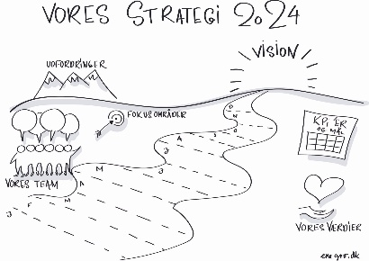
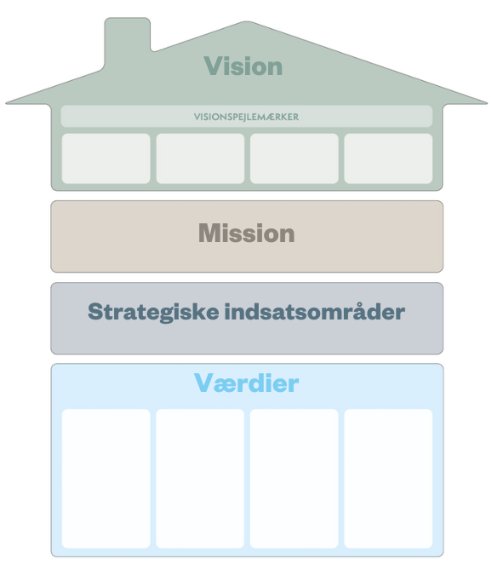
2
Formulate a strategic intent
Strategic intent in practice
Step-by-step guide for a group tasked with developing the strategic intent together
Start with the shared situation awareness and have the participants:
Reflect individually or in pairs and write ideas for strategic intent statements on post-it notes.
Share ideas and group them thematically.
Select the most important themes and discuss them.
Assign responsibility for writing a first draft of the strategic intent based on the dialogue and the next step in the process.
Objective:
To chart a shared course and formulate a vision for the future for the unit/group, based on the shared situation awareness.
Questions to help you develop a strategic intent:
1. Describe your strategic intent
Based on who/what the focus of the strategy is, write down what you want to achieve – what is your vision for your desirable future scenario?
2. Articulate the difference
What difference will achieving the strategic intent you’ve just formulated make – and for whom?
3. Identify signs of success
How can you see that you’re moving in the right direction?
For example changes in workflows, focus, organisation or measurable results.
Helpful hints
Involving more people in crafting your strategic intent increases a sense of ownership and meaning in relation to the work to follow.
A strategic intent can take many forms – from a short guiding statement to strategic benchmarks, a strategic path or a strategy house – depending on context and needs.
Guiding statement
Strategic
Benchmark
Strategic path
Strategy house
“We make knowledge useful – for students, researchers and society”

Slide 11
Unifying movements
Definition
A unifying movement brings together the collective forces that will move the organisation towards realising the strategic intent.
They are identified based on the intent and describe the movements that are most important for realising it.
These movements must be felt to be meaningful and engaging – something you want to contribute to and that speaks to you.
They can be expressed in the form of short motivational statements or themes that articulate the direction the organisation should move in and can be supplemented with goals or visions for the future that show progress towards your goal.
The goal is to:
create momentum and engagement around the strategic intent so everyone can see how their work aligns with the common goal.
3
Craft unifying movement statements
Aarhus
University

Slide 12
3
Craft unifying movement statements
Unifying movements in practice
Objective:
To articulate and rank the unifying movements that can bring the organisation closer to realising the strategic intent.
Step-by-step guide
Base your discussion on your strategic intent
Discuss what movements will be necessary to move you closer to realising the intent. A good way to structure this is by starting with reflection, individually in pairs, writing ideas down on post-it notes.
Craft motivational statements
Use short, engaging statements: ‘We have to move from ... to ...’ or ‘We will...’
Select the statements that are most compelling, motivational and clearly aligned with your strategic intent.
Align and adjust
If your strategic intent is very broad, a stakeholder analysis can help you identify what movements are most important for different stakeholders. You may have to repeat this process a few times to arrive at clear, motivational statements.
Examples of unifying movement statements
An NGO that must increase revenues to survive: ‘We’ll still be here in 100 years.’
Summer school programme facing threat of closure: ‘Shutting us down has to be unthinkable.’
A university college that wants to attract more degree programmes that address one of the major societal challenges: ‘Our graduates must bring skills and critical thinking to the digital workplace’
What these have in common:
They’re short, compelling and chart a course that can guide employees and managers in their day-to-day work.
Helpful hints
The unifying movement statements can be crafted collectively or refined by a smaller group. Involving more people creates greater ownership.

Slide 13
Short-term to-do lists
Definition
Short-term to-do lists are lists of concrete actions that can bring the organisation closer to realising the strategic intent.
Draw up at least one to-do list for each unifying movement – or more than one if the movement involves multiple units or teams.
Begin by getting an overview of what you’re already doing, what you need to change or stop doing and what challenges you need to solve to succeed.
Describe the items on the list in a concrete, actionable way – see the next slide for examples.
Your lists should cover a six-month period and should be regularly revisited and adjusted to ensure alignment with the unifying movement.
The goal is to:
get started quickly – without knowing the entire route in advance.
formulate concrete short-term tasks and adjust your course along the way.
make the strategy operational and actionable in the day-to-day.
4
Make short-term to-do lists
Aarhus
University

Slide 14

4
Make short-term to-do lists
Short-term to-do lists in practice
Step-by-step guide
Start by gaining a collective overview – in your team, unit or management team – of:
What are we already doing that is taking us in the right direction?
What should we start doing or stop doing (breaking habits) to move forward?
What known obstacles do we need to remove?
Where should we look for signs of success – concrete milestones, new behaviour or results?
Based on this overview, formulate and rank concrete tasks and assign responsibility for them.
You might want to put all of the group’s inputs up on a poster or whiteboard to get an overview.
Helpful hints
It’s a good idea for each team/unit/section to make short-term to-do lists – one per unifying movement.
You can also have one person draft the to-do list and then involve relevant people in the execution of the tasks.

Slide 15
Regular follow-up
Definition
Regular follow-up gives reflection on and adjustment of strategy work a set cadence. It’s a question of providing a framework in which relevant leadership forums regularly discuss:
Whether the local strategic direction is still appropriate and is driving movement in the desired direction,
what lessons have we learned and what results have we achieved since last time,
and where adjustments or revisiting priorities are necessary.
It’s also about keeping the strategy alive in the day-to-day – using it as a compass for operational decision-making and prioritising.
This is what we might call day-to-day prioritisation – the practice of continually bringing the strategy into play through the day-to-day choices, dialogues and actions at all levels of the organisation.
The goal is to:
sustain strategic focus in a busy operational context.
translate the strategy into consistent action, learning and prioritising.
create a common language and a consistent rhythm around the strategy across units and professional specialisations.
5
Follow up regularly
Aarhus
University
Notes:
Regular follow-up is a set cadence for reflection, learning and recalibration of your strategic work.
It’s a question of providing a framework in which relevant leadership and staff forums regularly discuss:
whether the strategy is still relevant and is driving movement in the right direction,
what lessons have we learned and what results have we achieved since last time,
and where adjustments or revisiting priorities are necessary.
It’s also about keeping the strategy alive in the day-to-day – using it as a compass for operational decision-making and prioritising.
This is called day-to-day prioritisation: the ongoing practice by which the strategy is translated into concrete choices, dialogues and actions at all levels of the organisation.

Slide 16
5
Follow-up in practice
Follow up regularly
To sustain focus on the strategy and ensure that you consistently check in to assess relevance and progress, it can be helpful to incorporate ‘day-to-day prioritisation’ into existing meeting structures at regular intervals – for example once per quarter.
Follow-up can take the form of a structured dialogue focusing on the past, the future and action. The questions can be tailored to local needs, and the dialogue should centre on a current shared situation awareness and the strategic intent.
Follow-up can be incorporated into existing meeting forums – one-on-one dialogues, leadership fora or department/school/unit meetings –so it becomes a natural part of operations rather than an add-on.
Focus on collective reflection and learning, not monitoring.
How to be consistent about day-to-day prioritisation
Focus area | Questions for reflection | Typical actions
Direction/ Day-to-day prioritisation | How do we keep the strategic direction alive in the day-to-day? | Incorporate the unifying movement statements in ongoing development work and prioritisation discussions at meetings, SDD, one-on-one projects and decisions – use the strategic intent as a guide.
Example of how to structure a quarterly follow-up
Focus area | Questions for reflection | Typical actions
Preparation | What do our key figures, finances, well-being, progress, etc. show about our current status? | Collect data and observations as a basis for dialogue
Past | What have we achieved since last time, and what can we learn from it? What is the current situation? | Share results and lessons learned If relevant, do mini-SWOT
Future | Are the unifying movement statements still fit for purpose, or do they need adjustment? And what are your concrete goals and priorities right now? | Revise focus areas, adjust wording of unifying movement statements and agree on new steps
Action | What are the most important tasks for the coming months – who does what? What is the most important leadership task in the coming quarter? Cross-organisational: do we need others, or do they need us? | Update short-term to-do lists Ensure relevant coordination
Helpful hints
Follow-up and day-to-day prioritisation don’t necessarily require new processes – ‘just’ awareness.
When the strategy becomes a natural part of dialogue and decisions in the day-to-day, a strong connection between theory and practice is forged.

Slide 17

Other tools

Slide 18
Process plan – structuring your strategy work
A process plan allows you to structure and schedule strategy work and follow-up. It spells out who plays what role when and how progress and learning are to be ensured.
The plan can be integrated into existing meeting cadences in order to incorporate the strategy into ongoing leadership processes, or be a separate process, depending on needs and context.
The point of the process plan is to provide collective transparency and ownership – not to become an administrative document.
Download process plan template
Activity | Objective | Potential participants | Timeframe/frequency
1. Define the playing field | Define the objective of the strategy work and its scope – for example, a department, a theme or a cross-organisational team | Leadership team, any key staff | Launch
2. Shared situation awareness | Build a shared understanding of the current situation, challenges and opportunities | Managers, staff, external partners where relevant | 1-2 workshops
3. Strategic intent | Articulate the desired course and descriptions of future success | Leadership team, selected staff | After the situation awareness process
4. Unifying movements | Identify the most important organisational trajectories that can ensure alignment with the intent | Leadership team, selected staff | 1-2 meetings
5. Short-term to-do lists | Make the strategy operational by translating it into concrete actions and priorities | Teams, departments, project groups | 1 meeting, subsequently quarterly or as needed
6. Regular follow-up with fixed cadence | Review progress and lessons learned | Leadership team, relevant forums | Regularly/ for example quarterly

Slide 19
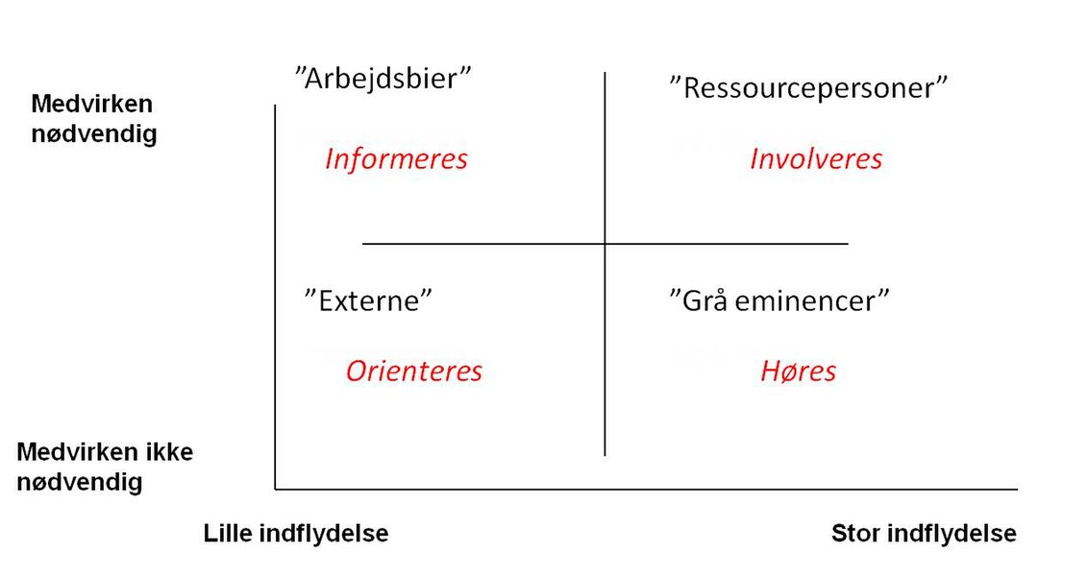
Stakeholder analysis – identify stakeholders and their needs
A stakeholder analysis is used to identify the people, groups or organisations that are affected by or contribute to the strategy work.
You can use it to inform your unifying movement statements and prioritise what stakeholders are most important to involve.
Here’s how to perform one:
Identify stakeholders, categorised by importance and need for involvement.
Discuss how best to manage them: inform, involve, collaborate with or assign responsibility.
Carry out the analysis in the leadership team or a smaller project group to ensure situation awareness and ownership.
Download template for detailed stakeholder analysis
Example of framework for stakeholder analysis
‘Worker bees’
‘Resources’
Participation required
Keep informed
Involve
‘External’
‘Powerbrokers’’
Keep in the loop
Consult
Participation not required
Minor influence
Major influence

Slide 20


