Slide 1
Introduction to Remuneration and Expense form Foreign Partners (REEX)
Summer University

Slide 2
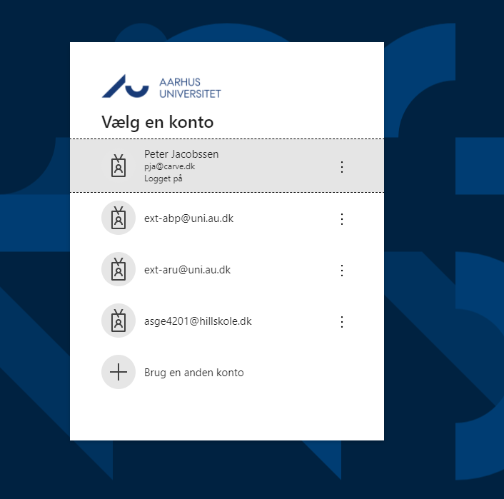
Log on
1
First, log on to Remuneration and Expense form Foreign Partners (REEX-System)
2
Log on using your AU ID and password

Slide 3
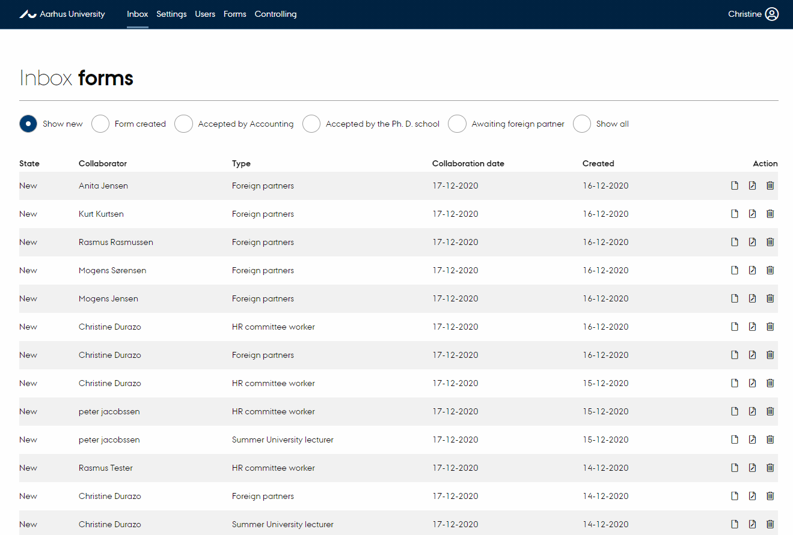
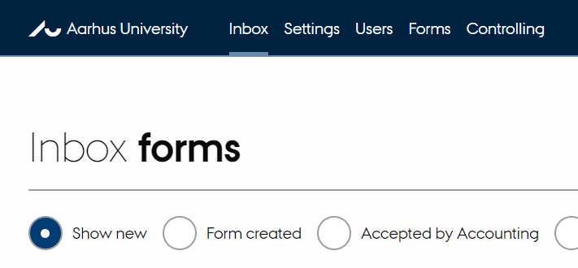
How to find Forms
1
When you have logged on, you will see the inbox with the forms
2
Click “Forms” in the top bar

Slide 4
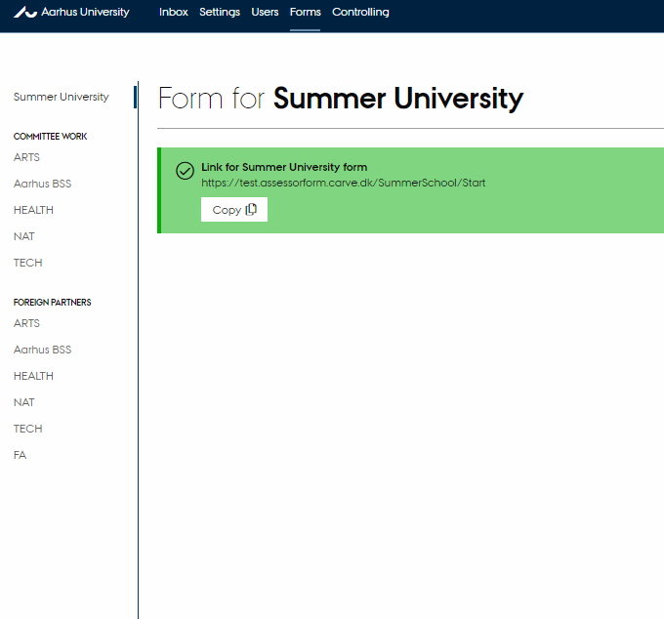
How to copy links
1
In the green bar, click “copy” and then add the copied link to a new email.

Slide 5
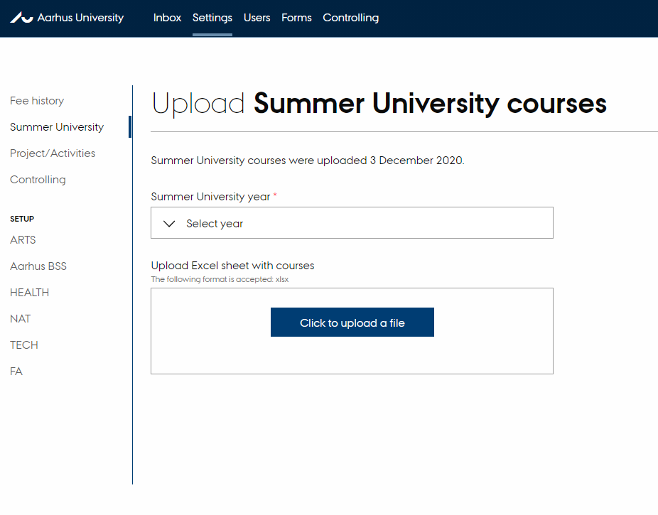
How to upload courses
1
In the top bar under “Settings”, click “Summer University” on the left.
2
Then select “Click to upload a file” and upload the new file with the summer courses. Remember to select the relevant year for the file in question.
3
When the first settlements have been registered, it is not possible to update the file.

Slide 6
The user page
The following slides contain the pages which the international partner must complete.

Slide 7
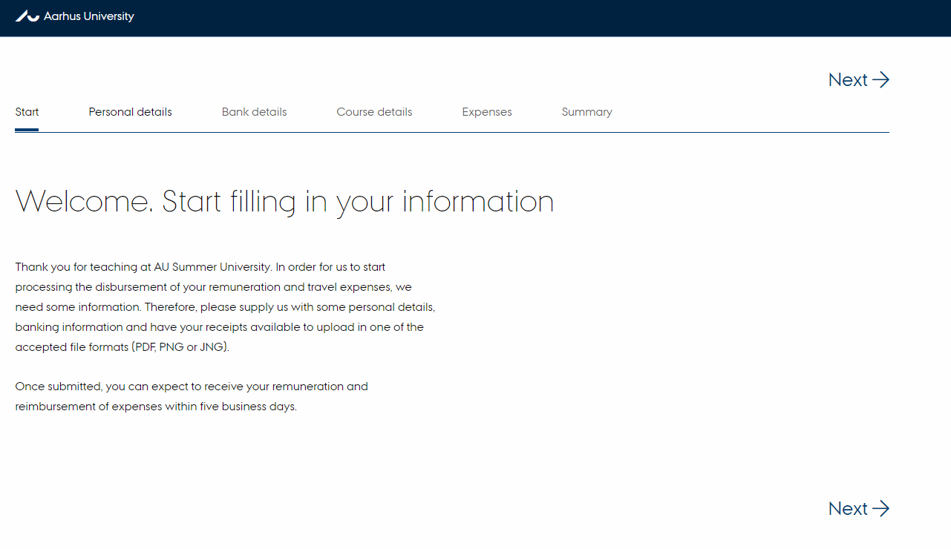
Welcome page

Slide 8
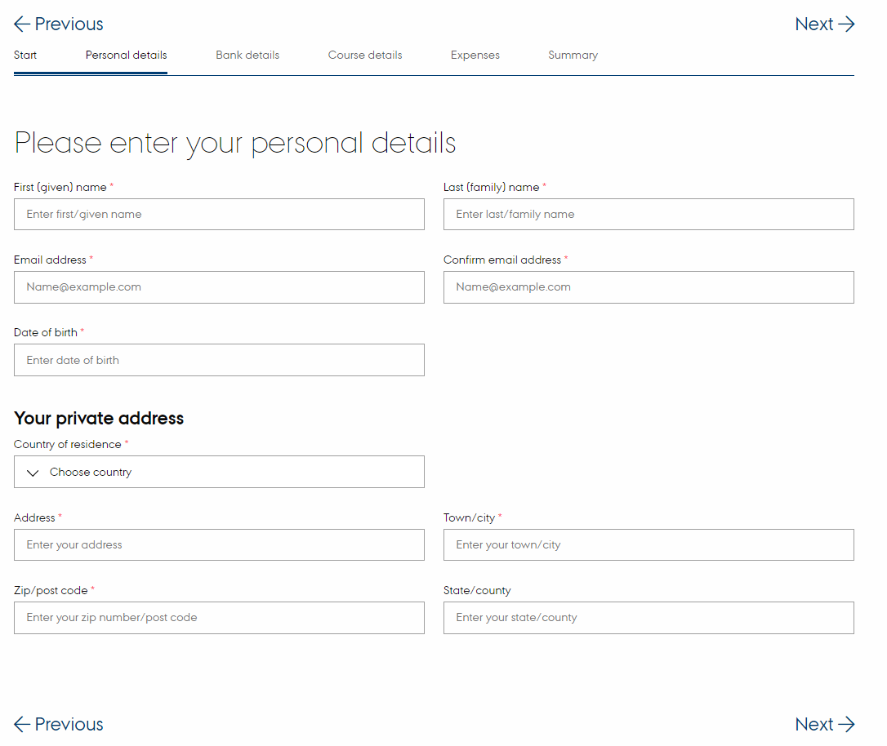
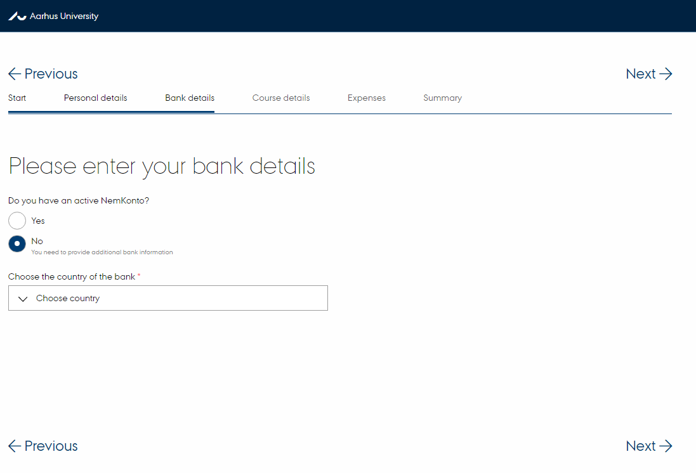
Personal details and bank details

Slide 9
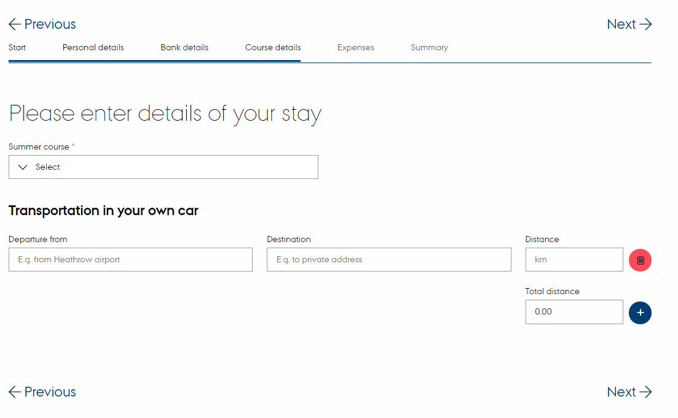
Details of your stay

Slide 10
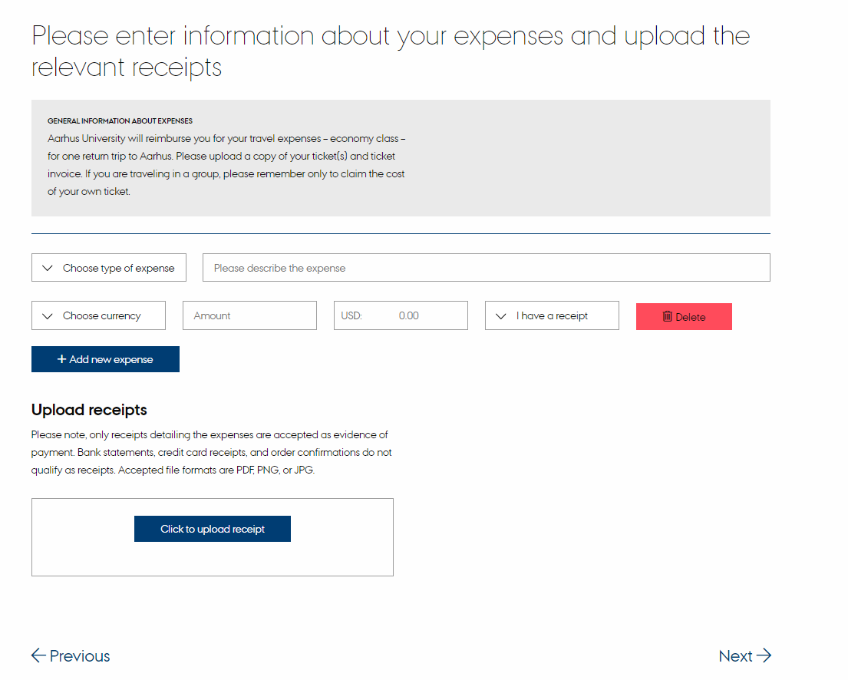
Expenses

Slide 11
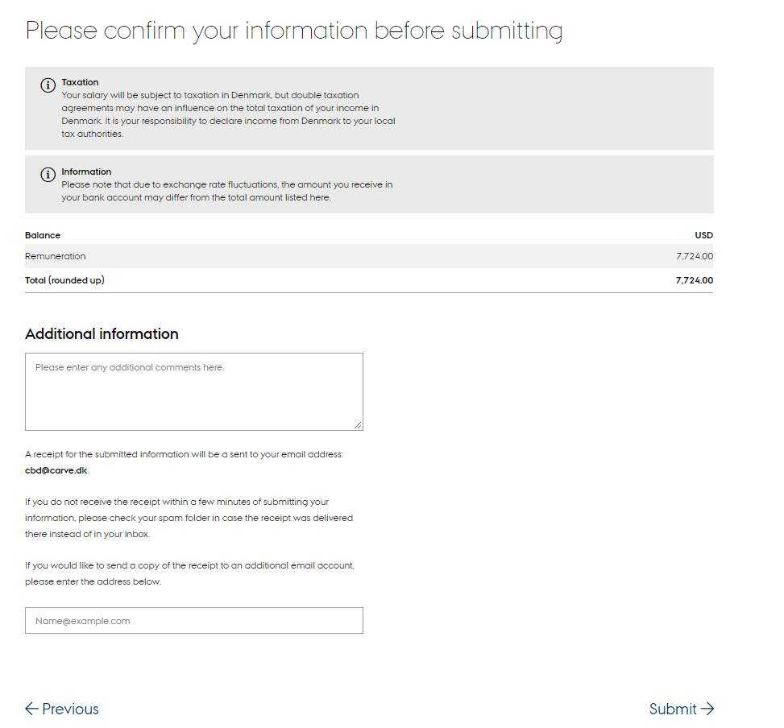
Summary

Slide 12
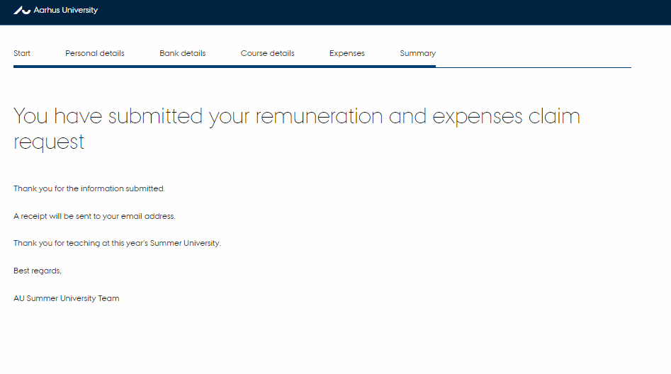
Thank you – the form has been submitted

