Slide 1
Introduction to Remuneration and Expenses form Foreign Partners (REEX)
Foreign Partners

Slide 2
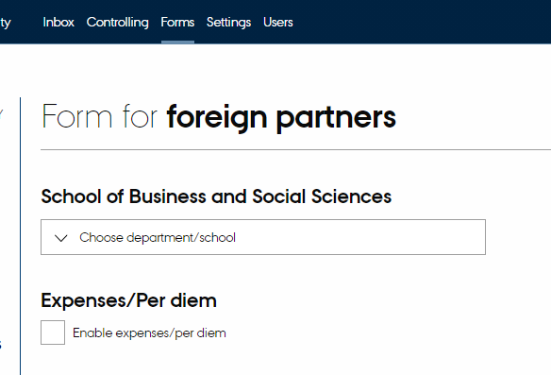
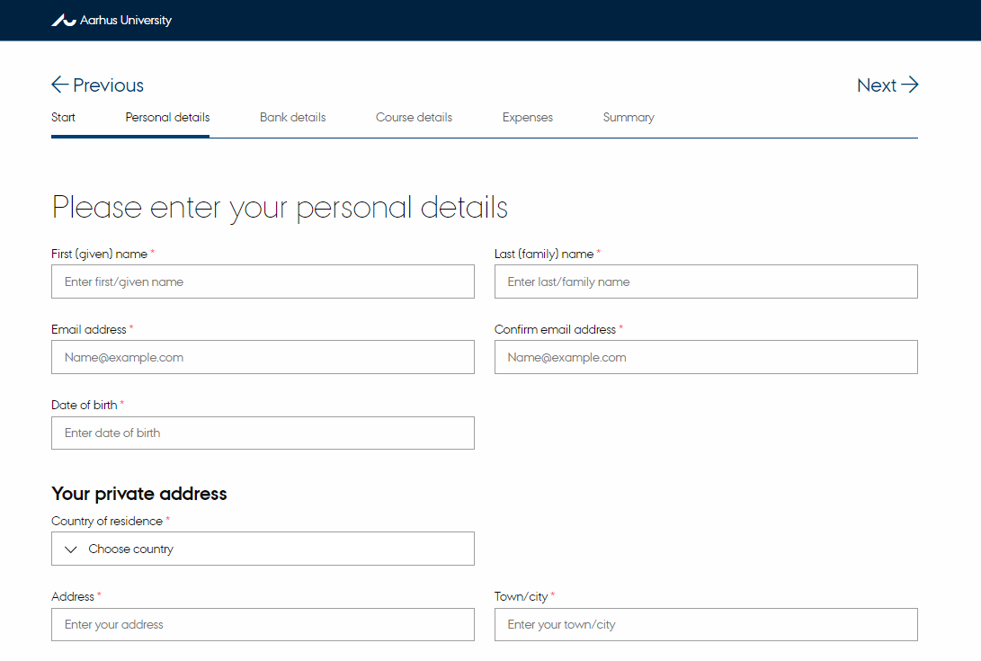
REEX assessment Flow
1. Add information to the REEX form
2. Write an email text and add the link
3. The international partner completes and submits the form. The form will then be checked automatically by Accounts.

Slide 3
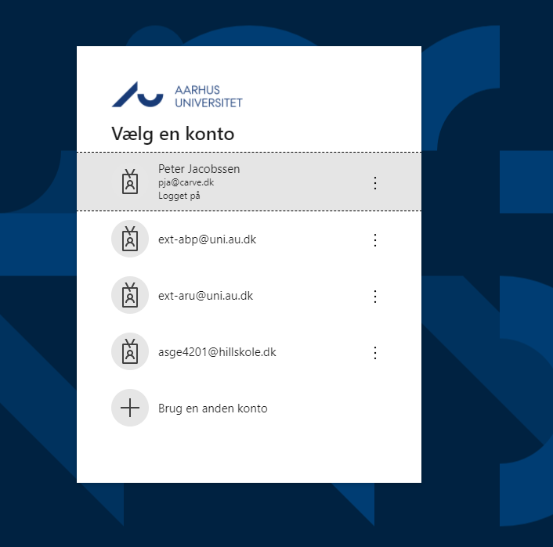
Log on
1
First, log on to Remuneration and Expense form Foreign Partners (REEX-System)
2
Log on using your AU ID and password

Slide 4
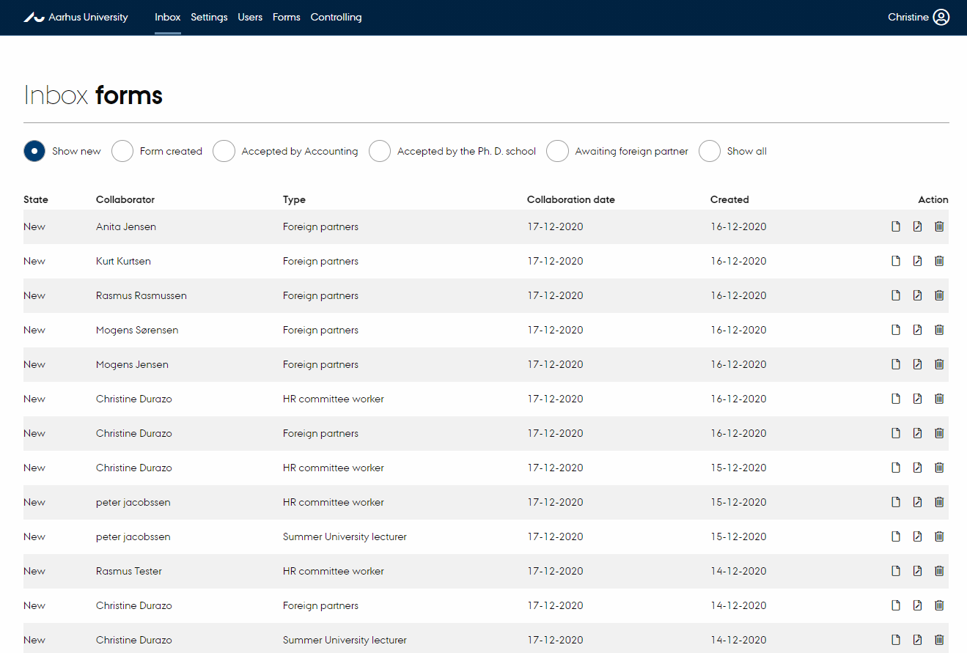
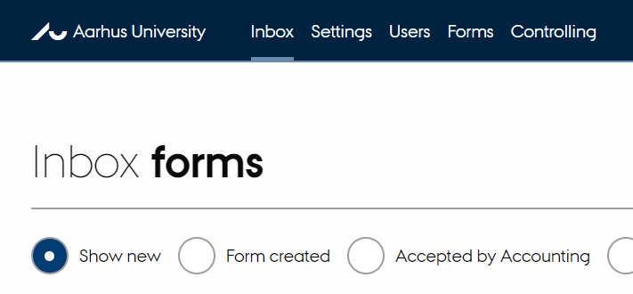
Find the Link page
1
When you have logged on, you will see the inbox with the forms
2
Click “Forms” in the top bar

Slide 5
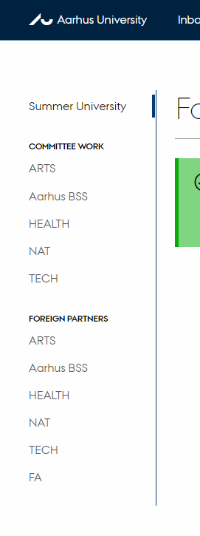
Find your faculty
1
Click the relevant faculty, under “Foreign partners” on the left.

Slide 6
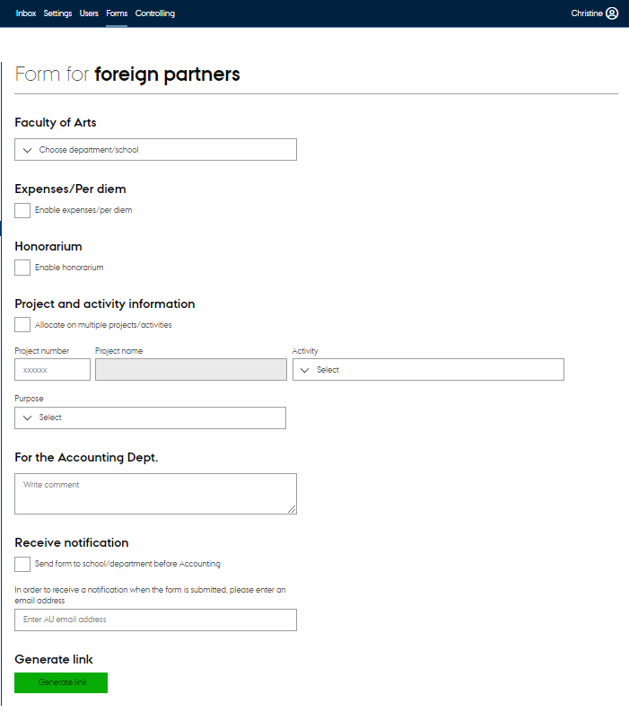
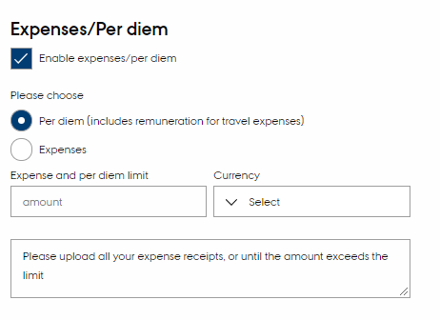
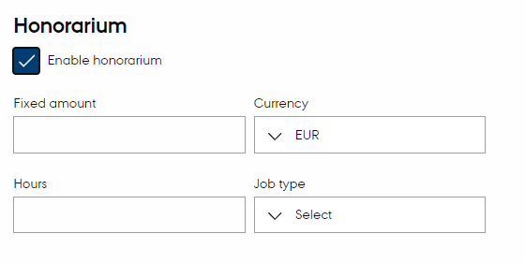
Add information
1
Complete the required fields
2
Under “Expenses/Per diem”, choose whether the form concerns settlement of expenses or per diem allowances. It is also possible to specify an expense limit, if agreed in advance. Please choose Expenses if only expenses are to be reimbursed, choose per diem (includes remuneration for travel expenses) for daily allowance and reimbursement of expenses.
3
If you open the “Honorarium” box, you can add an amount – either as a fixed amount or based on a number of hours. The hours worked will then be presented as a total sum to the international partner.
(Please note that the travel department cannot make changes to the Honorarium.)
4
Any expenses/remuneration can be divided between more than one project/activity by checking the box “Allocate on multiple projects” (see more on the next page)

Slide 7
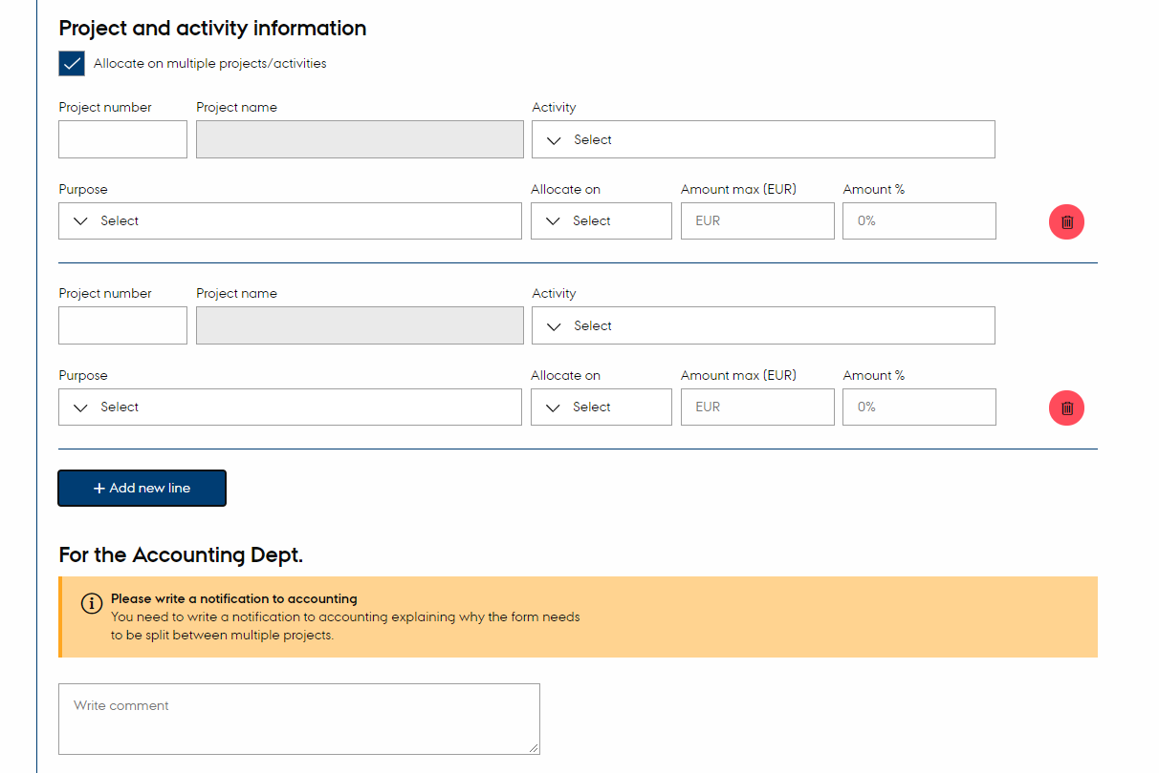
Divide the settlement of expenses between more than one project/activity
1
Choose the relevant purpose by clicking the dropdown list under “Purpose”.
Please note that when choosing ‘other’ the system freezes, therefore press esc to continue
2
Under “allocate”, you can select whether the project in question should cover expenses or remuneration.
3
You can divide the expenses by stating a specific amount or percentages. If you state percentages, the total must be 100%.
4
When your expenses relate to more than one project, please use the comments field to inform Accounts how the expenses should be divided (e.g. accommodation in connection with xx project and plane ticket in connection with xx project)

Slide 8
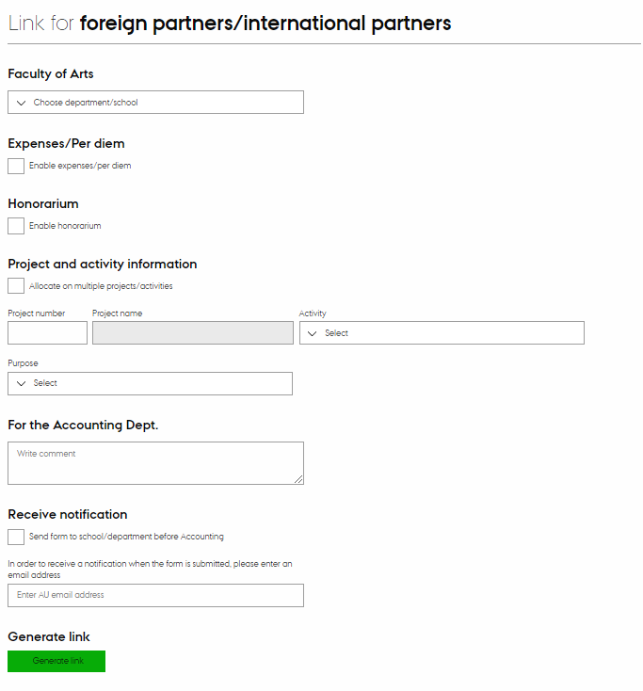
How to generate links
1
Check the box “Manual control of Form”, if you wish to check the form before it is sent to Accounts.
NB! Remember to approve the form in the administration module to avoid process delay (see p. 9)
2
Click “Generate link” and then click “Copy” – the link has now been copied.
3
Open a new email and write an email text to the international partner. Add the link to the form in the email.

Slide 9
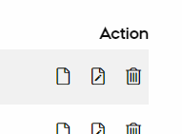
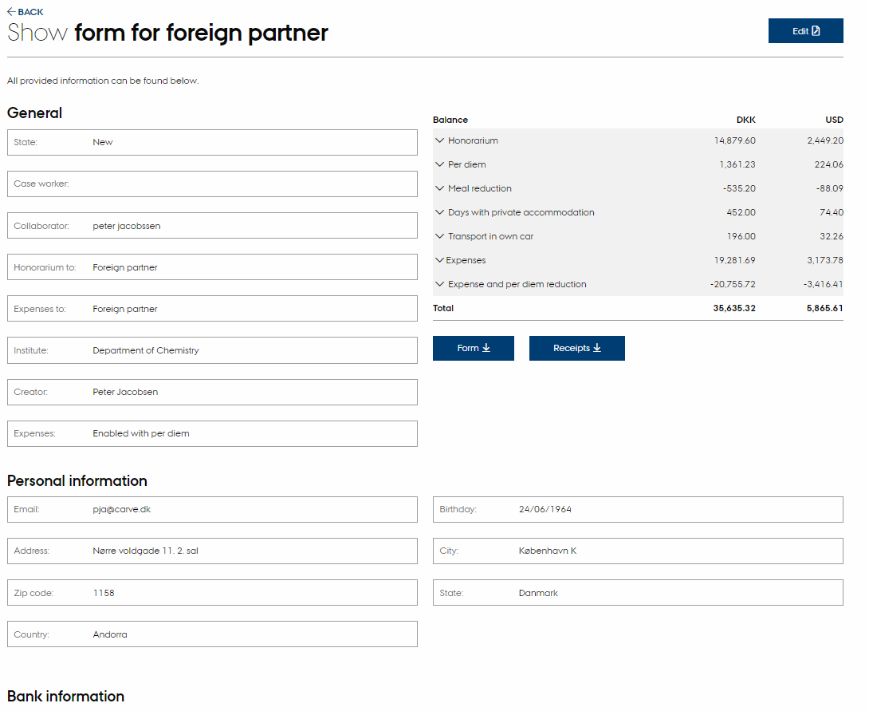
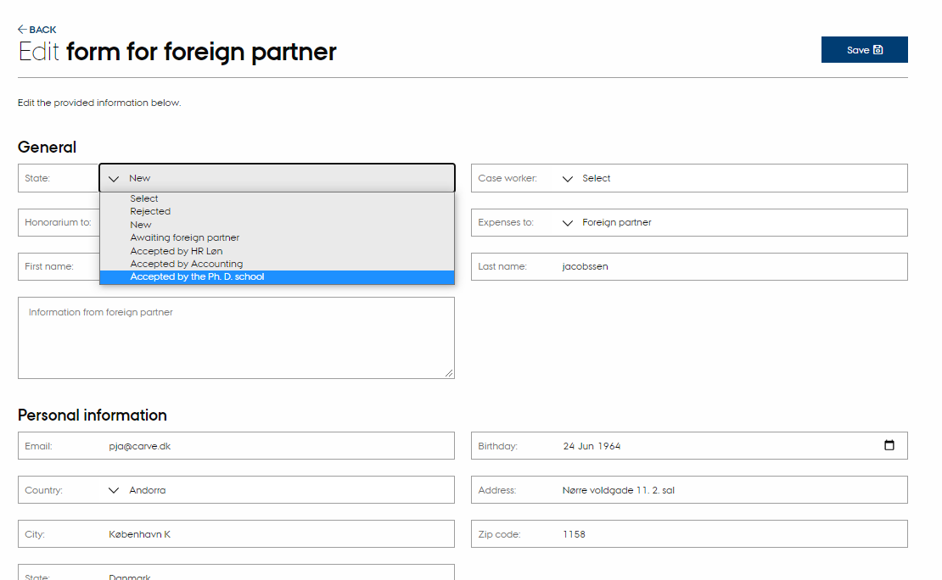
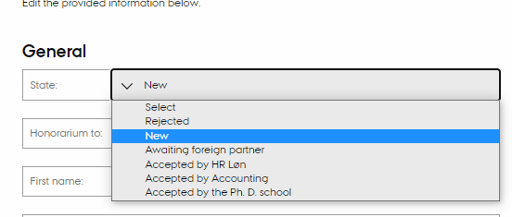
Checking the form
Show
1
To check the form, find the form in the Inbox and click “show” or “edit”.
Edit
2
When you have checked the form, you must change the form’s status under “edit”
3
Here you change “state” to “Accepted by Department/School”
4
The form will now be sent to Accounting

Slide 10
The user page
The following slides contain the pages which the international partner must complete.

Slide 11
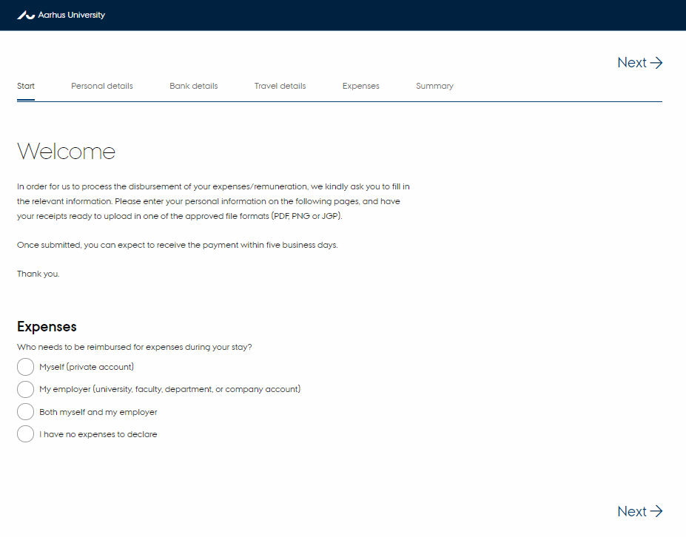
Welcome page

Slide 12
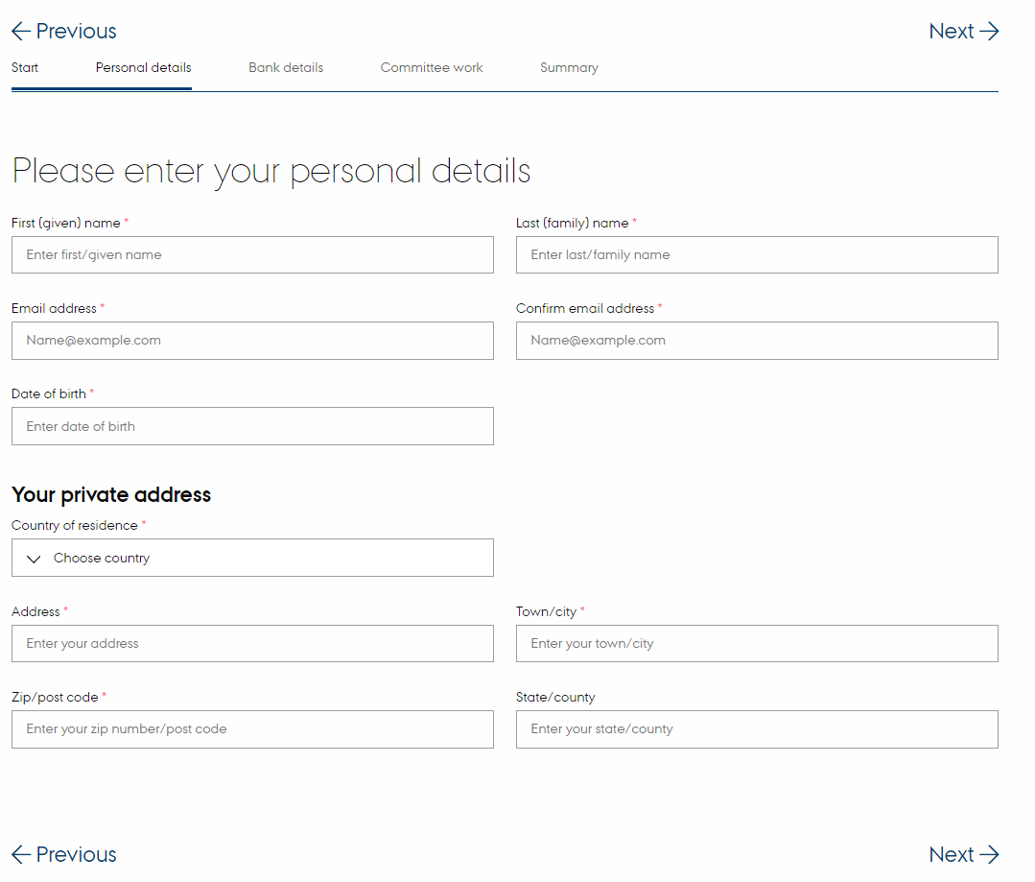
Personal details and bank details
Please make sure that are no spaces or special characters when filling in the bank details.

Slide 13
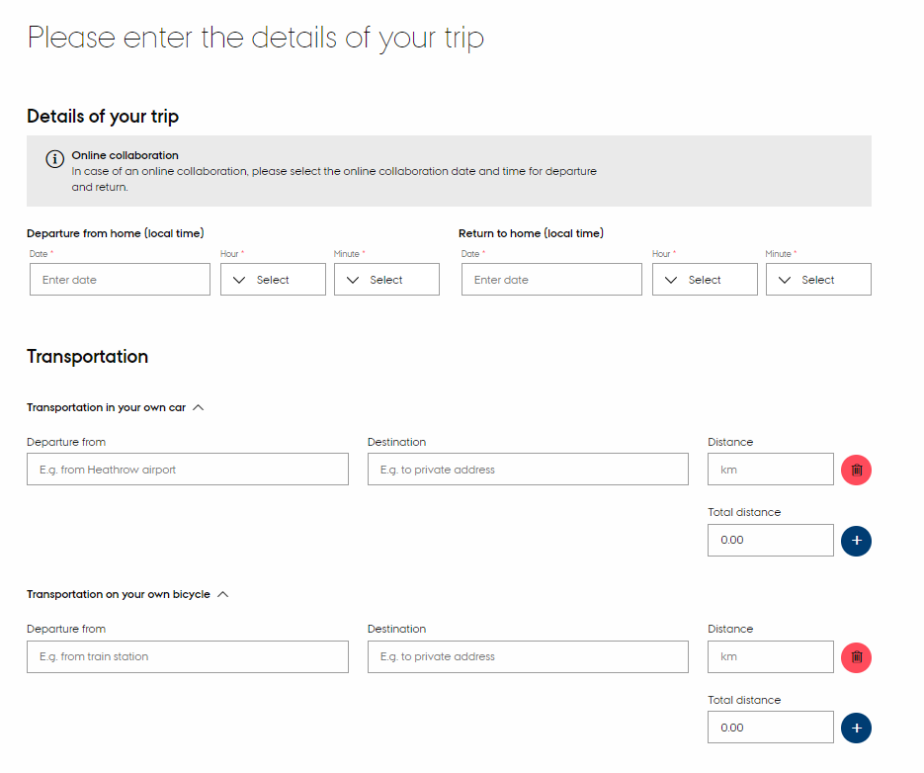
Details of your trip

Slide 14
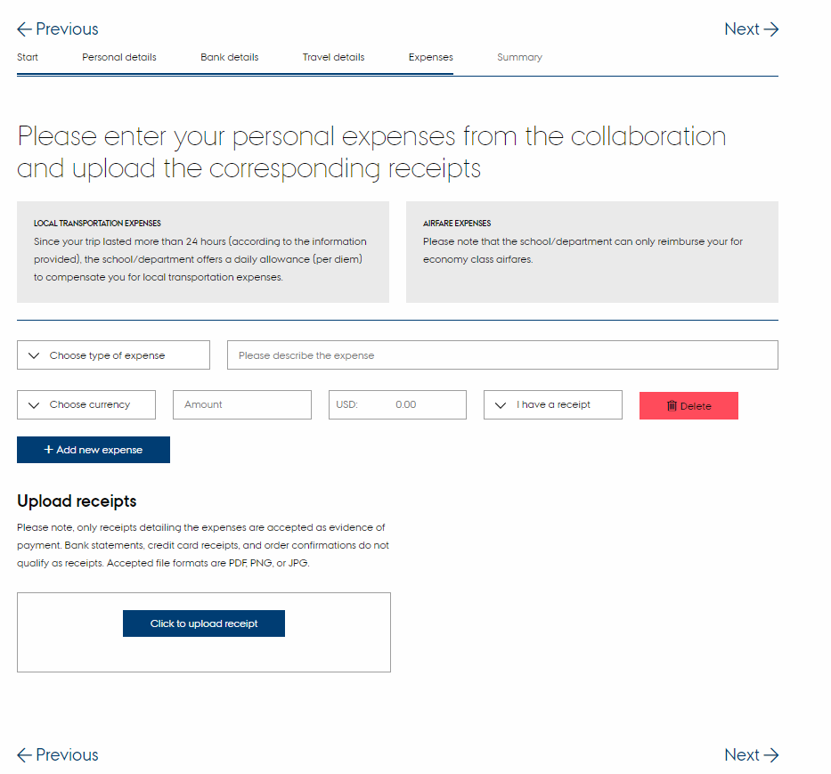
Expenses and receipts

Slide 15
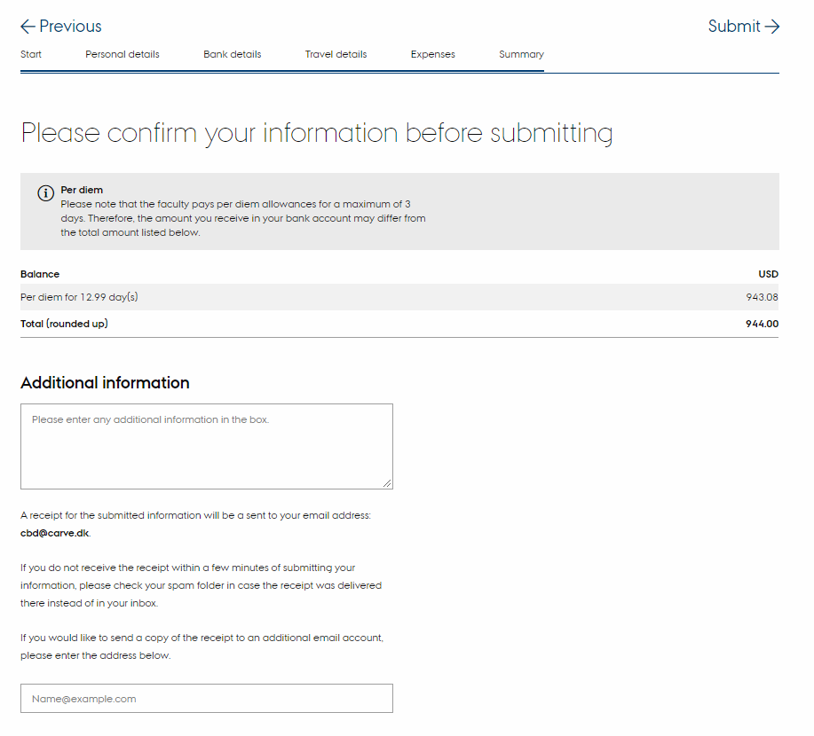
Summary

Slide 16
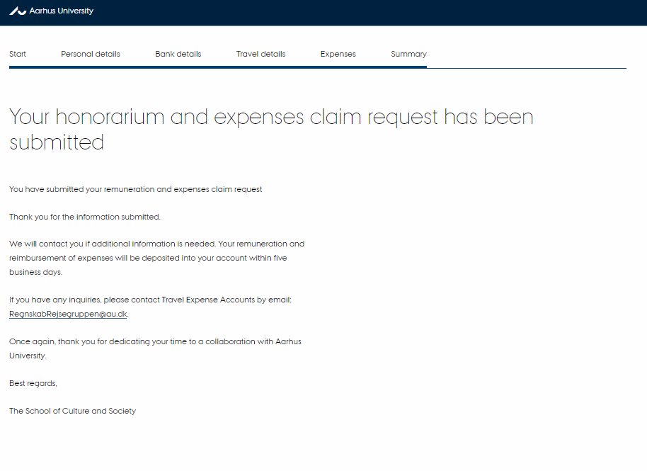
Thank you – the form has been submitted

